Slide 1
PMO Implementation Final & Project Closure Report
Prepared By: Hari Thapliyal
Vedavit Project Solutions
www.pmlogy.com
Date: 27-Apr-18

Slide 2
Summary Report Against Agreement

Slide 3
Objective as per the Agreement
# | OBJECTIVES: | Status
1 | To deliver specific PMO services in line with minimum standards, policies and methodologies, focusing on continuously improving processes to optimise operational efficiency. | FI
2 | Delivering best practice project management tools and templates, providing subject matter expertise around project and programme governance. | FI
3 | Developing reporting frameworks, producing standard project reporting templates, reviewing and challenging the content with PMs. | FI¹
4 | Focusing and entail collaboration with Business, Operations, Finance, Compliance, IT and other functions. | FI
5 | Driving forward improvements in Project quality and ensuring a joined-up approach to PMO and Project Management between the Business and other areas. | FI
6 | Data Analysis and Interpretation - providing reporting and analysis statistics of delivery during the project lifecycle. | FI
7 | You will guide the internal team to manage and maintain resourcing plans, tracking resource availability, managing Dashboard Reporting and be liaison point between Finance, Business and Project Managers. | FI
FI: Fully Implemented, PI: Partially Implemented, NI: Not Implemented

Slide 4
Other Activities as per the Agreement
# | Other Activities | Status
1 | Gap Analysis by review of existing facility/systems, which includes Processes, Systems, Tools and People. | FI
2 | Planning (estimation, scheduling, budgeting, baseline, who does what and when and how) | FI
3 | Decide PMO head, Project Managers, Project Management Team members from various departments (TEAM) | FI
4 | Conduct workshops (3 days) on fundamental of project management. | FI
5 | Conduct workshops (3 days) on MS-EPM enterprise project management & MSP (Microsoft Project) tools. | FI
6 | Refine roles, responsibilities & accountabilities of all. | FI
7 | Train all PMO team sit with each project manager & PMT and understand what they understood, what they are doing and what they are supposed to do. | FI
8 | Install MS / EPM tools. Recommend for apt tool for TEAM requirement and train the people. | FI
9 | To start with, select 20-30 critical projects and distribute those among existing project managers. | FI¹
10 | Oversee the plans prepared by Project Managers for these projects and help upload in EPM. | FI
11 | To ensure PM & PMT start using the tool on regular basis. | FI
12 | Design Project Management Dashboard for Senior Management. | FI
13 | Project Management Process Design. | FI
14 | Implement the processes in the tool. | FI

Slide 5
Key Deliverables as per the Agreement
# | Key Deliverables | Status
1 | To establish a fully functional PMO on or before 31st January 2018, that covers all the projects effectively and efficiently. | FI
2 | All jobs as per CDD with ZERO LD in the most efficient manner with OPTIMUM use of resources. | FI
3 | Make it clear with the existing Team and framework how many projects max they are capable of handling. | FI¹
4 | Creating the dashboard that must highlight every deviation so that the corrective action can be real time. Dashboard format to be shared with the Management prior to implementing. Dashboard access must be management decision. | FI
5 | Guide and ensure proper preparation of Schedules, data capturing, monitoring and job analysis after completion, Job completion meeting to discuss best practices, mistakes, action to be taken to avoid mistakes etc. | FI
6 | Hand hold the PMO team at least for 6 months. | FI

Slide 6
Detail Report Against Agreement

Slide 7
What is achieved
PMO Setup
A strong new PM
PM culture with different level of planning and tracking
Action focused meeting, discussions and plan
Every project is on management dashboard

Slide 8
What not done and will take time to strengthen
Metrics driven PMO
KPI driven roles and incentives for PMs
OPM3 of PMI has a 5 stage Project Management Maturity Model. This consulting work helped TEAM to reach Level 3. Major part of Level 4 & 5 is part of continuous journey and it will take another 6-12 month time in organization life.
Level 1 : Initial
Level 2 : Standardize
Level 3 : Measure
Level 4 : Control
Level 5 : Continuous Improvement

Slide 9
What was done
Trainings
System setup
System customizations
Ensuring people understand the value of process and following the same
Process documentation

Slide 10
Biggest challenge at TEAM
In order to continue this beautiful journey TEAM need to cross some big hurdles and move on
Stable and good IT infrastructure for all PMs, PMTs, HoDs [at present machines are slow, internet not available, power-trip machine reboot, they can check the progress only from office desktop etc.]
Motivating people to update the Kanban board on daily basis.
Till it become organizational DNA, keep system live by every days rigorous follow up, check, questions, inspiration etc. [This need to come from senior/top management. Manage through the systems, system data not verbal discussion, gut and intuition.]
Consistent, unifying, true view of information only from PWA (Project Web App).

Slide 11
CEO Dashboards
Projects, Issues, Dispatch Summary
LD, Pending ABG, PBG
Operational KPI (Schedule & Efforts)

Slide 12
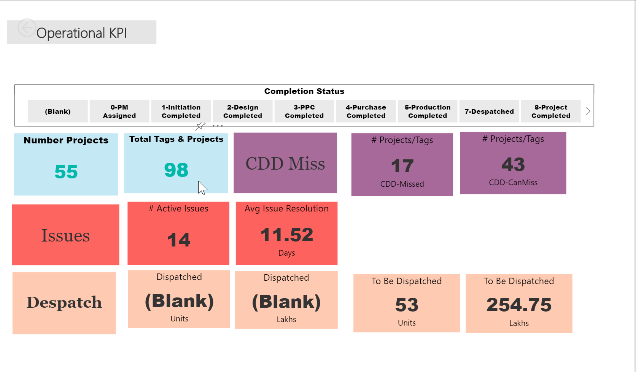
Projects, Issues, Dispatch Summary

Slide 13
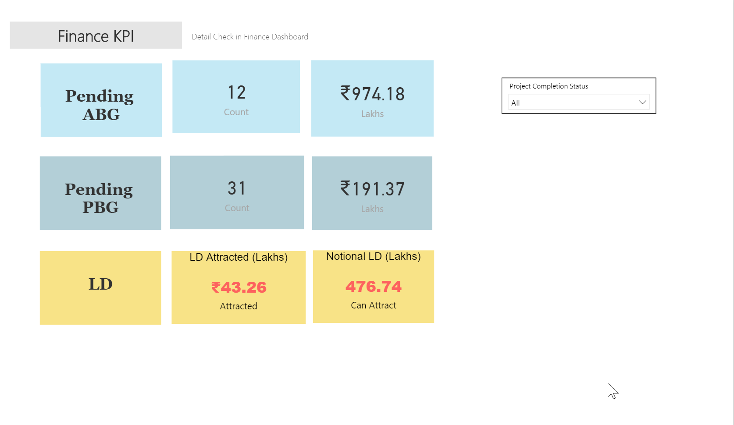
LD, Pending AB, PBG

Slide 14
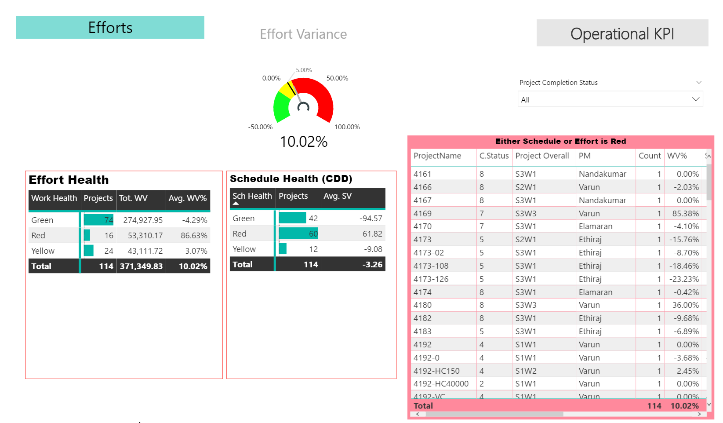
Operational KPI

Slide 15
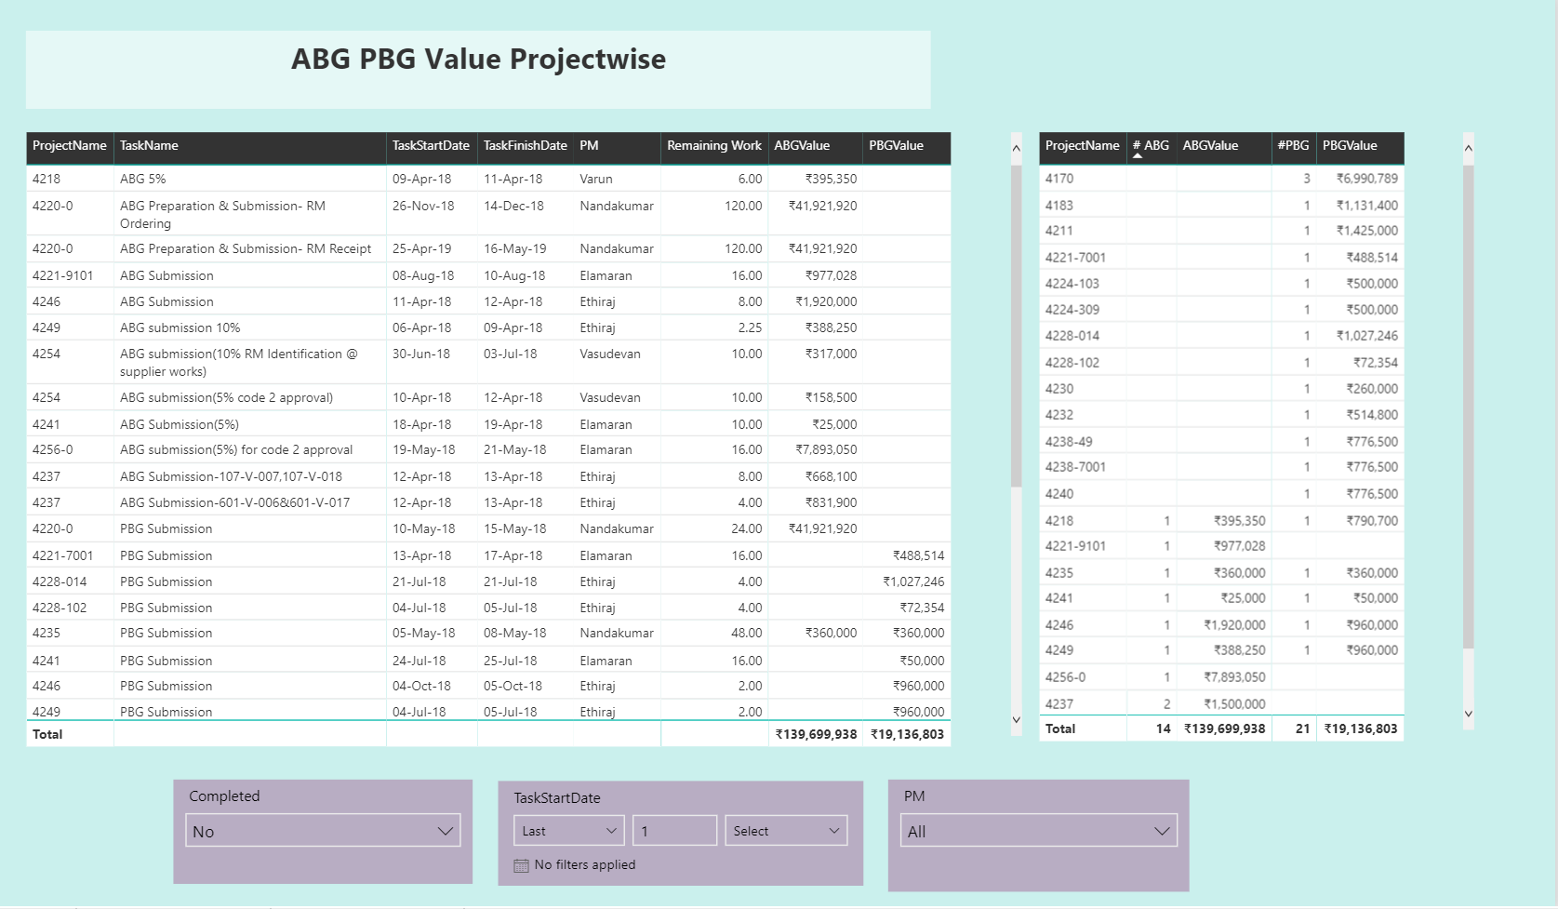
ABG PBG Report

Slide 16
PMO Dashboards

Slide 17
PMO Head Dashboards
Bird’s Eye View
Production Resources (Demand vs Capacity)
Production Resources (Demand vs Capacity)
Projectwise Resource Demand
Resource Requirement (# of Resources)
Budget, Actual & Saving Comparison
Baseline, Regular, EV, Actual, Timesheet (Work)
Baseline, Actual, Work, EV, TS Hours Trend
Schedule Alert
Work Variance
Schedule Variance
Monthwise Dispatch Report
Datewise Dispatch Report
Dispatch Value Graph
Action Register (BI Analysis)
Liquidity Damage Penalty Report
PM Workload Analysis

Slide 18
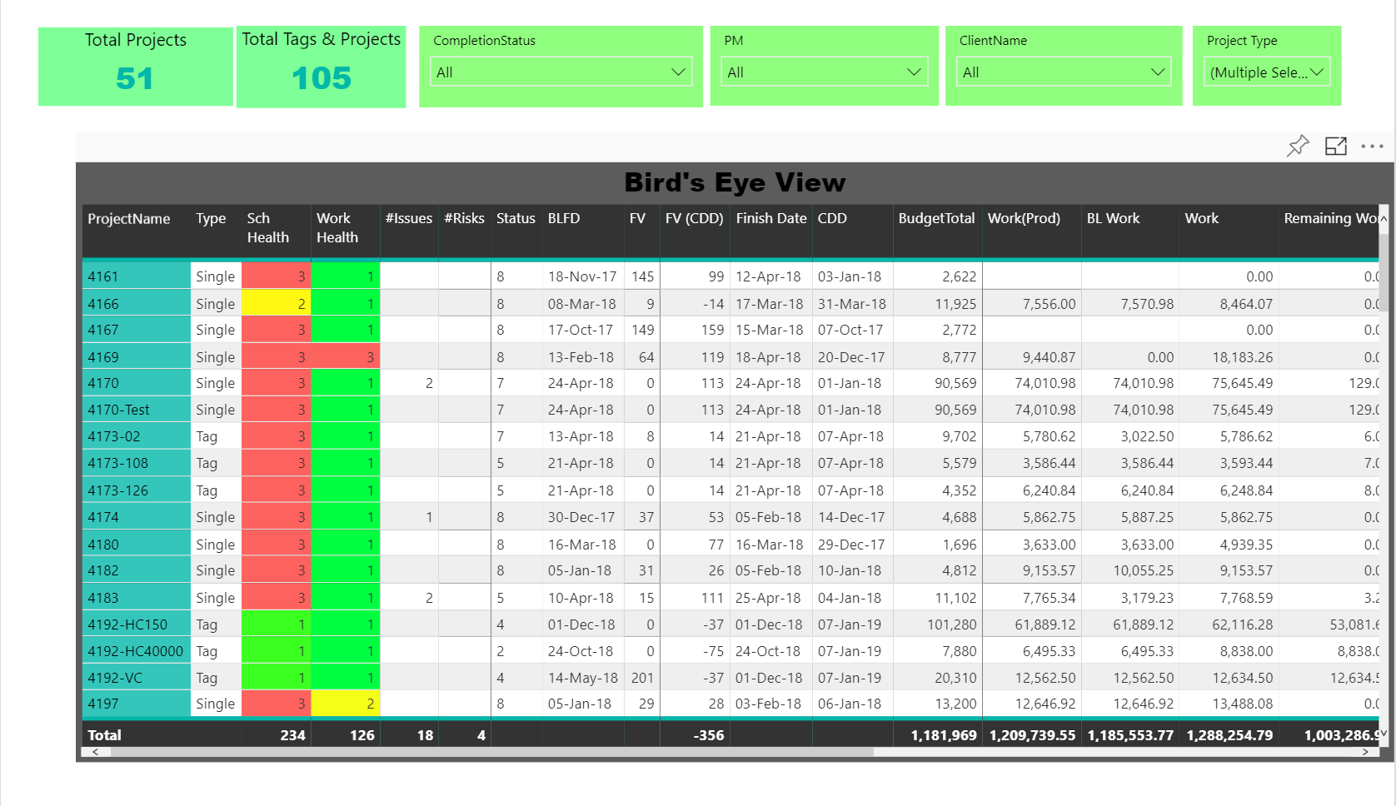
Bird’s Eye View

Slide 19
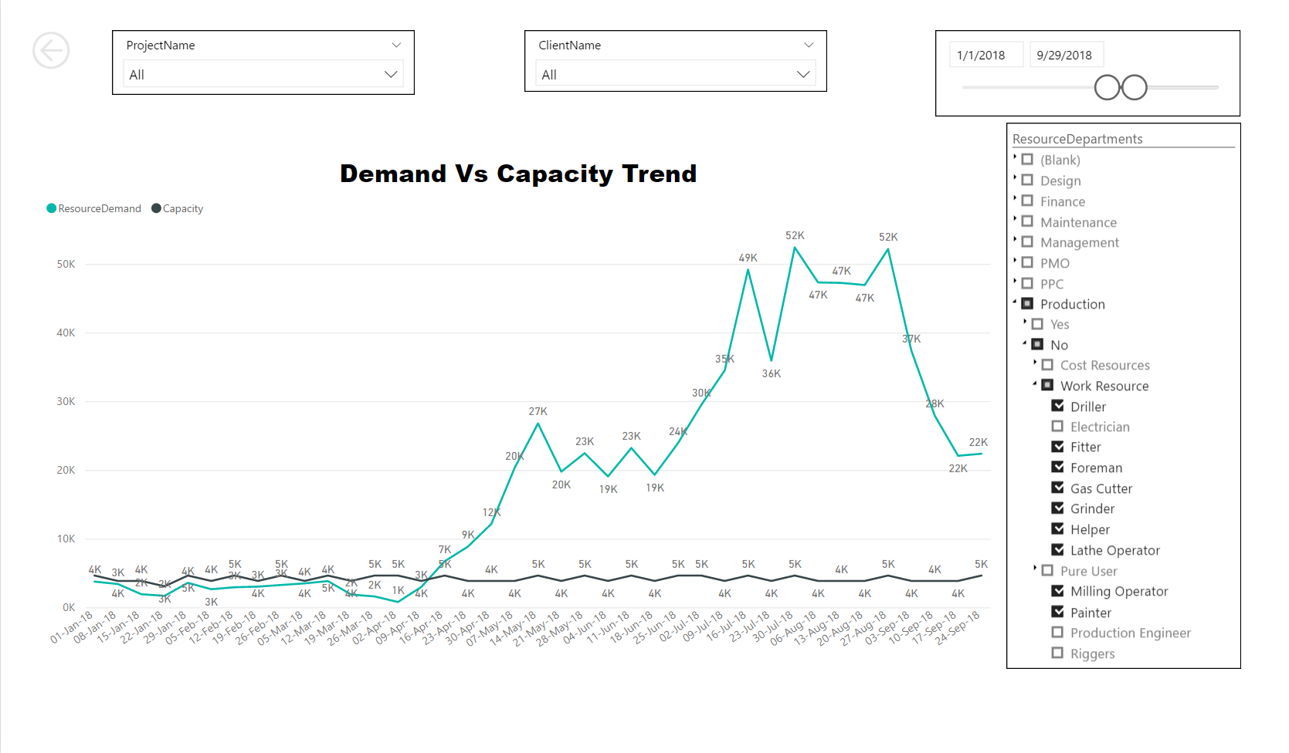
Production Resources (Demand vs Capacity)

Slide 20
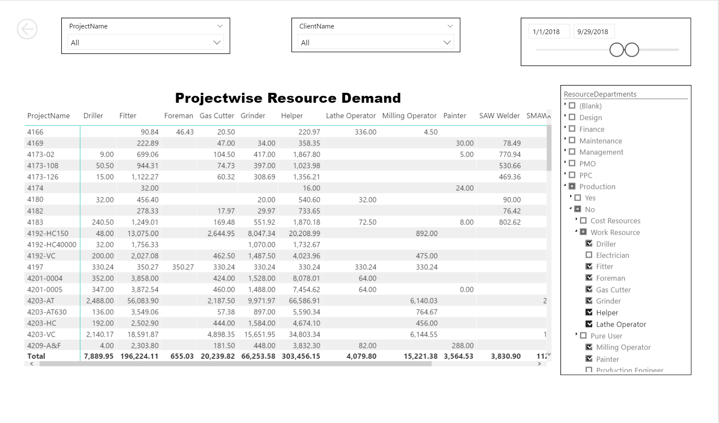
Projectwise Resource Demand

Slide 21
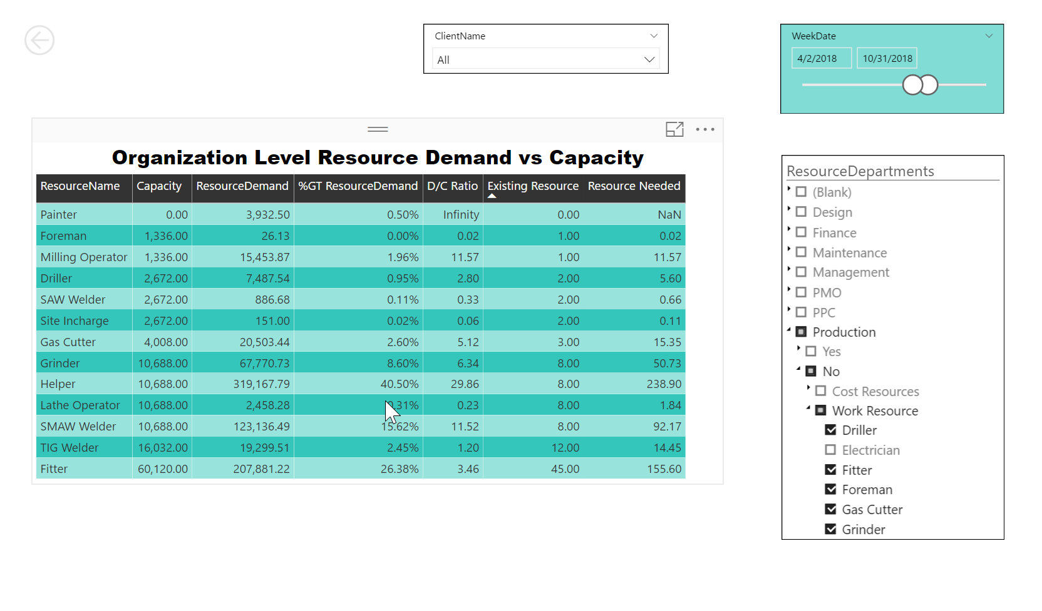
Resource Requirement (# of Resources)

Slide 22
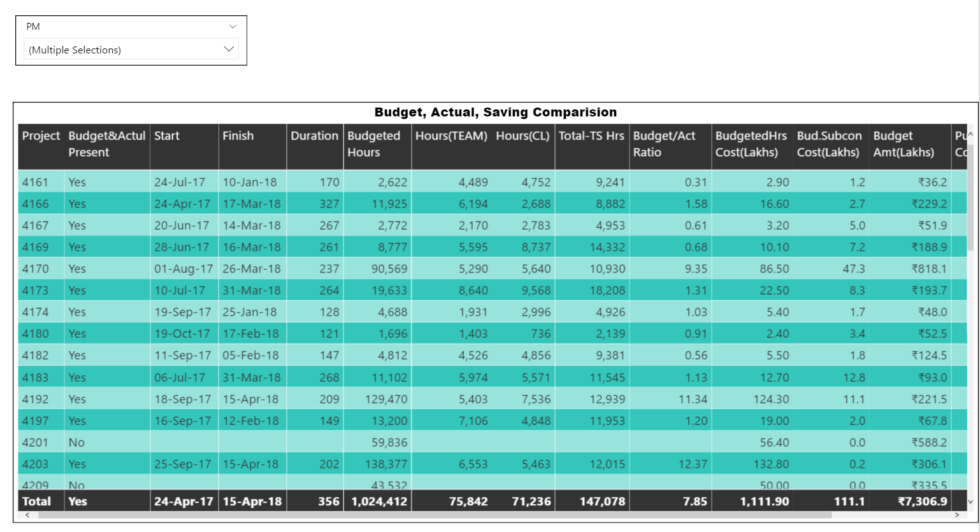
Budget, Actual & Saving Comparison

Slide 23
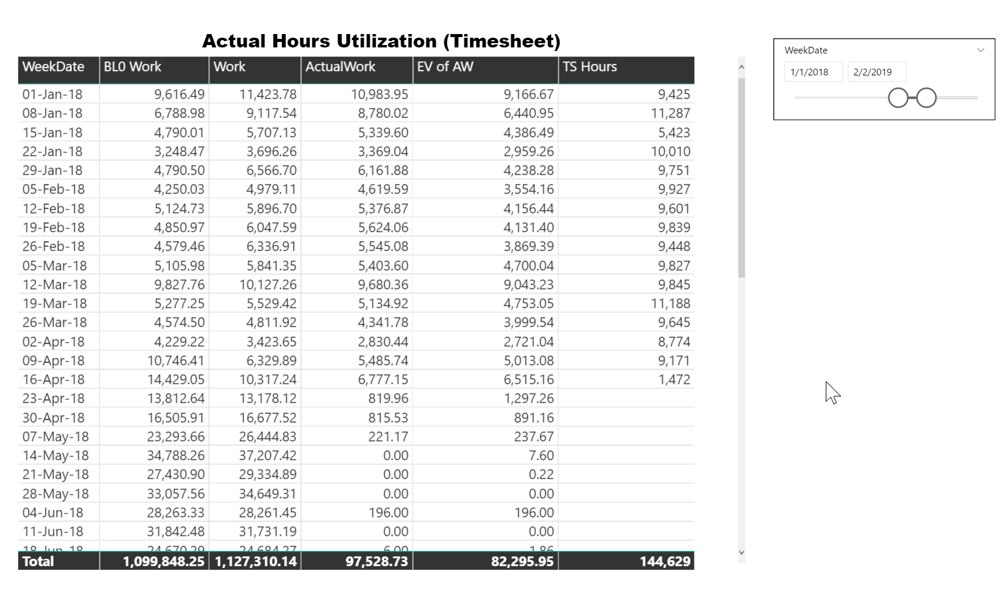
Baseline, Regular, EV, Actual, Timesheet (Work)

Slide 24
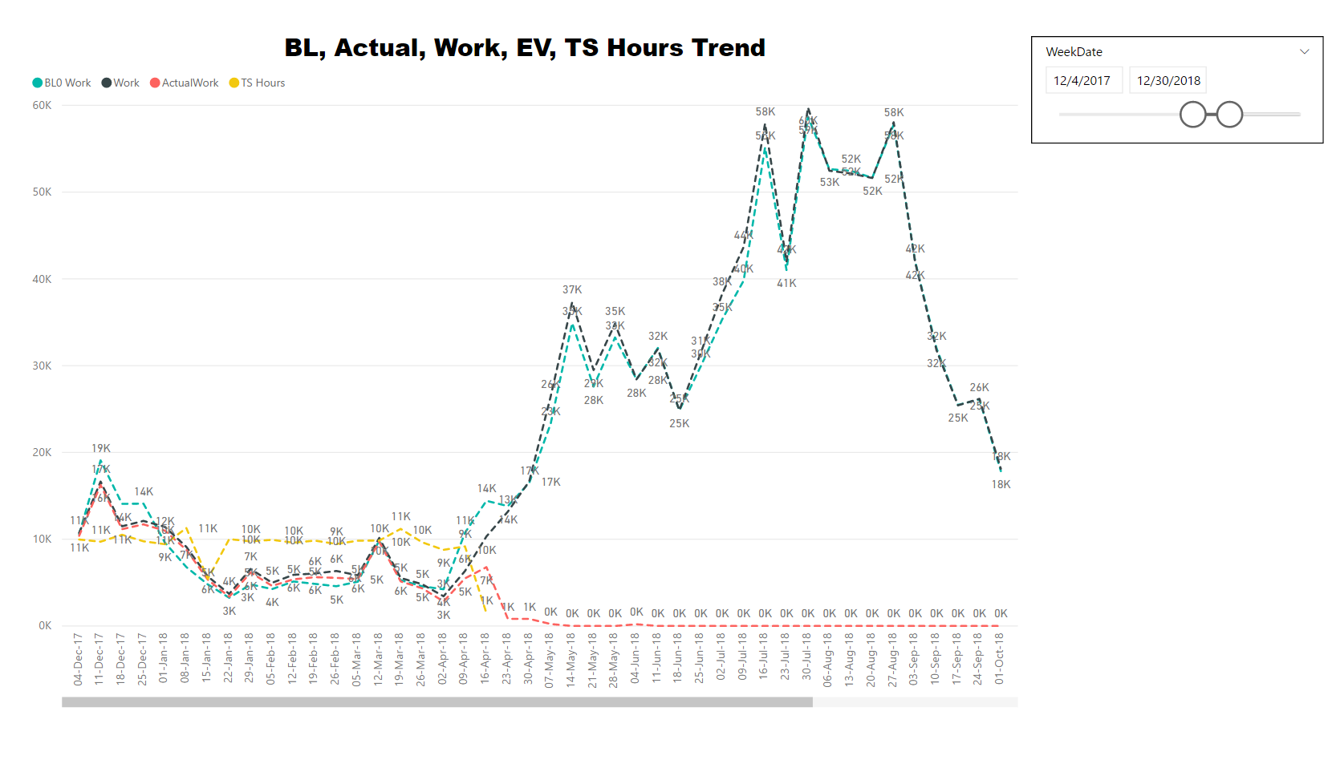
Baseline, Actual, Work, EV, TS Hours Trend

Slide 25
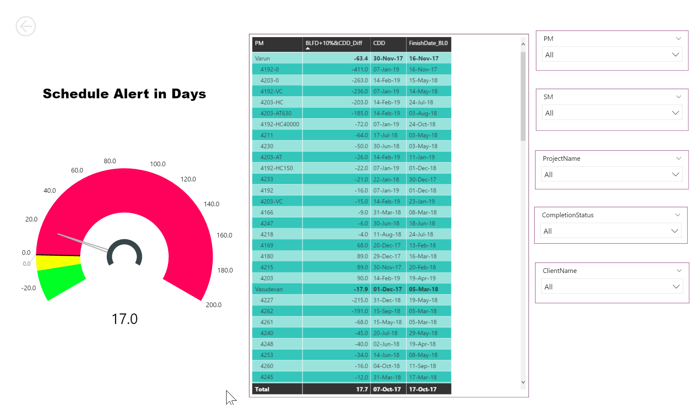
Schedule Alert

Slide 26
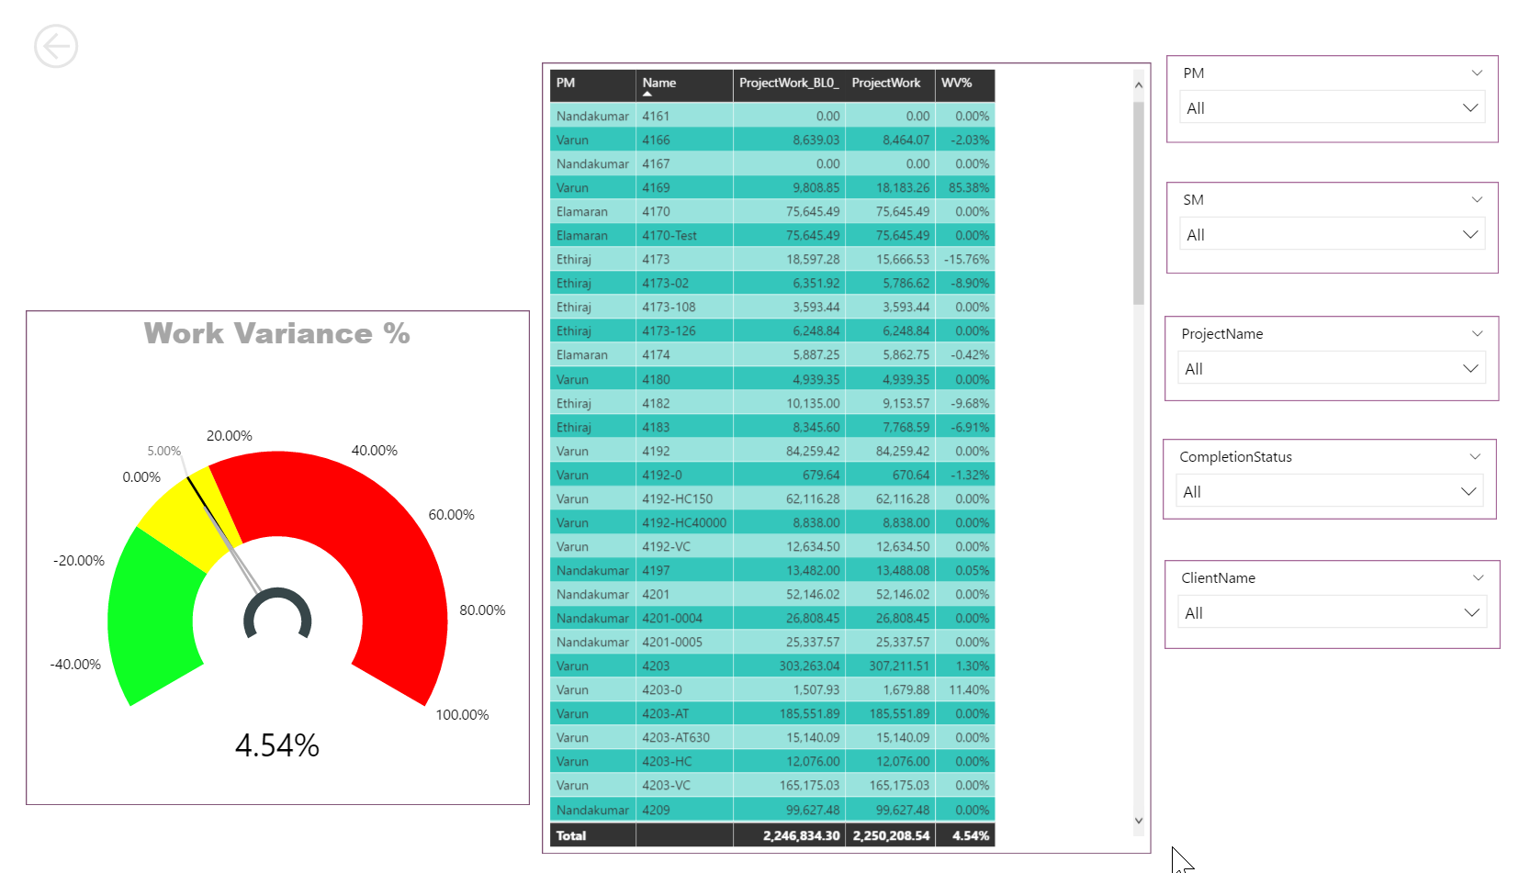
Work Variance

Slide 27
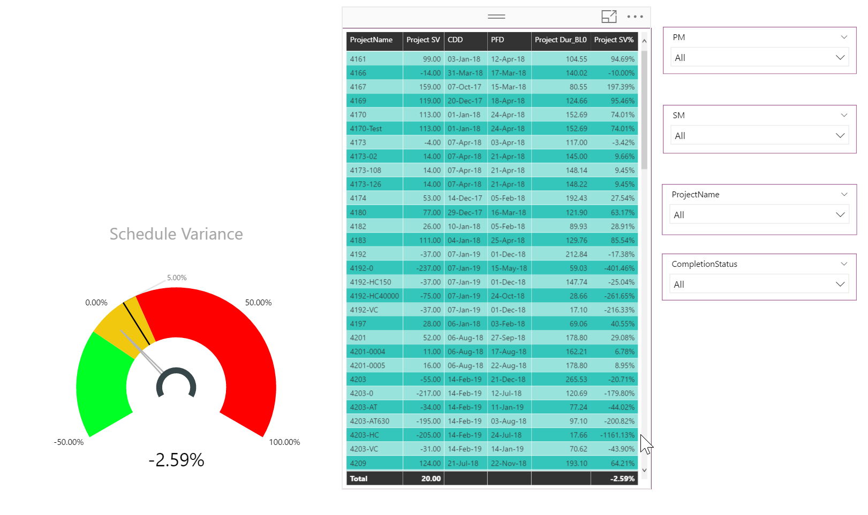
Schedule Variance

Slide 28
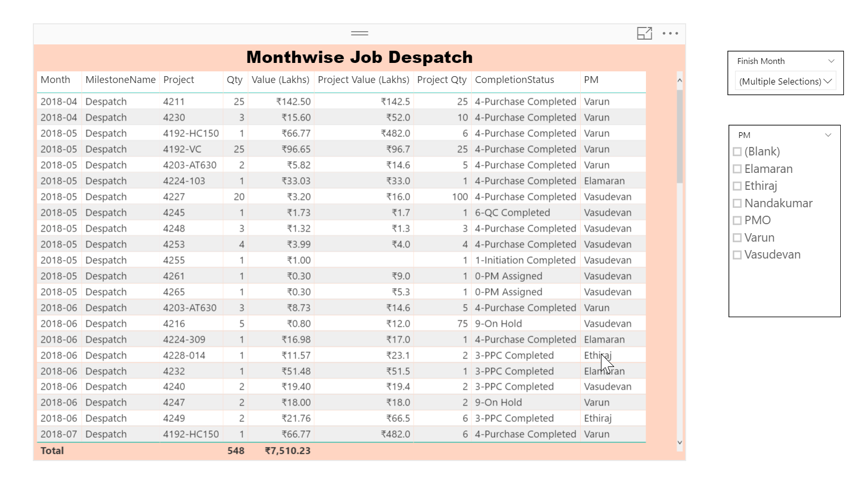
Monthwise Dispatch Report

Slide 29
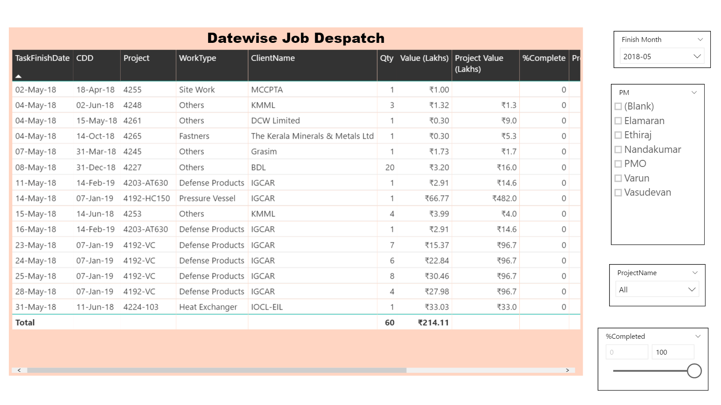
Datewise Dispatch Report

Slide 30
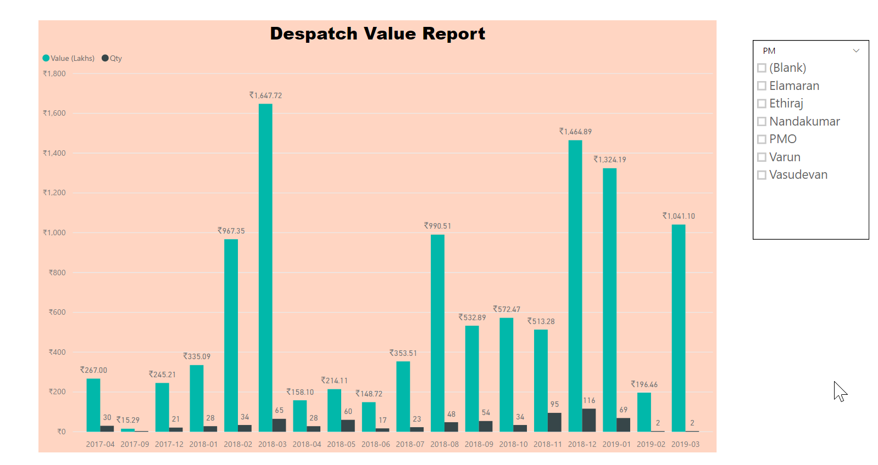
Dispatch Value Graph

Slide 31
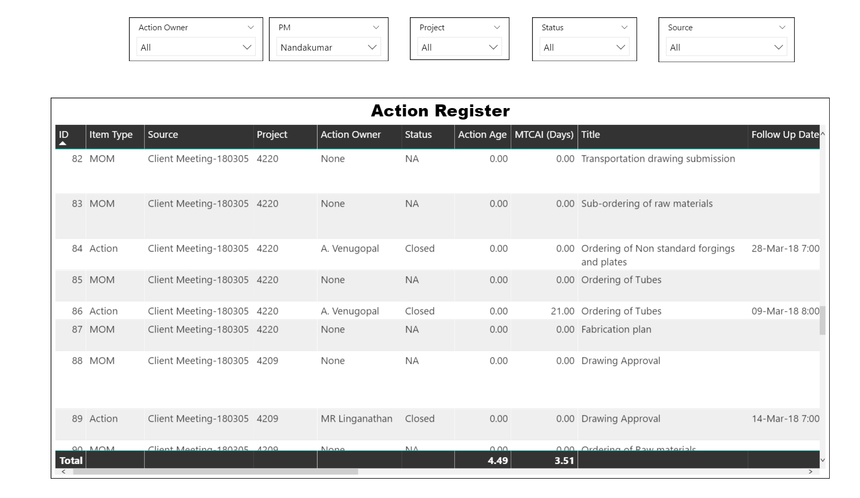
Action Register

Slide 32
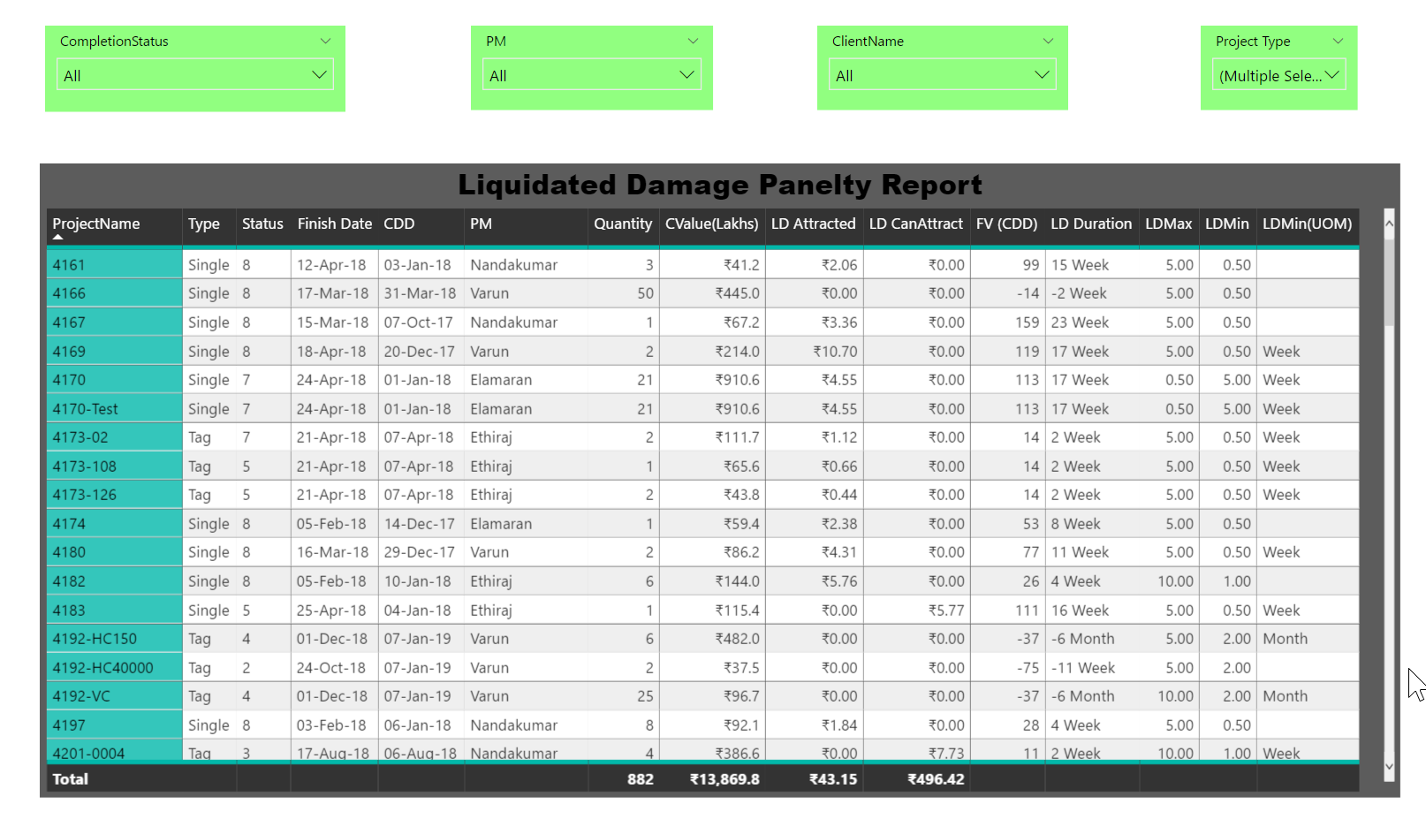
Liquidity Damage Penalty Report

Slide 33
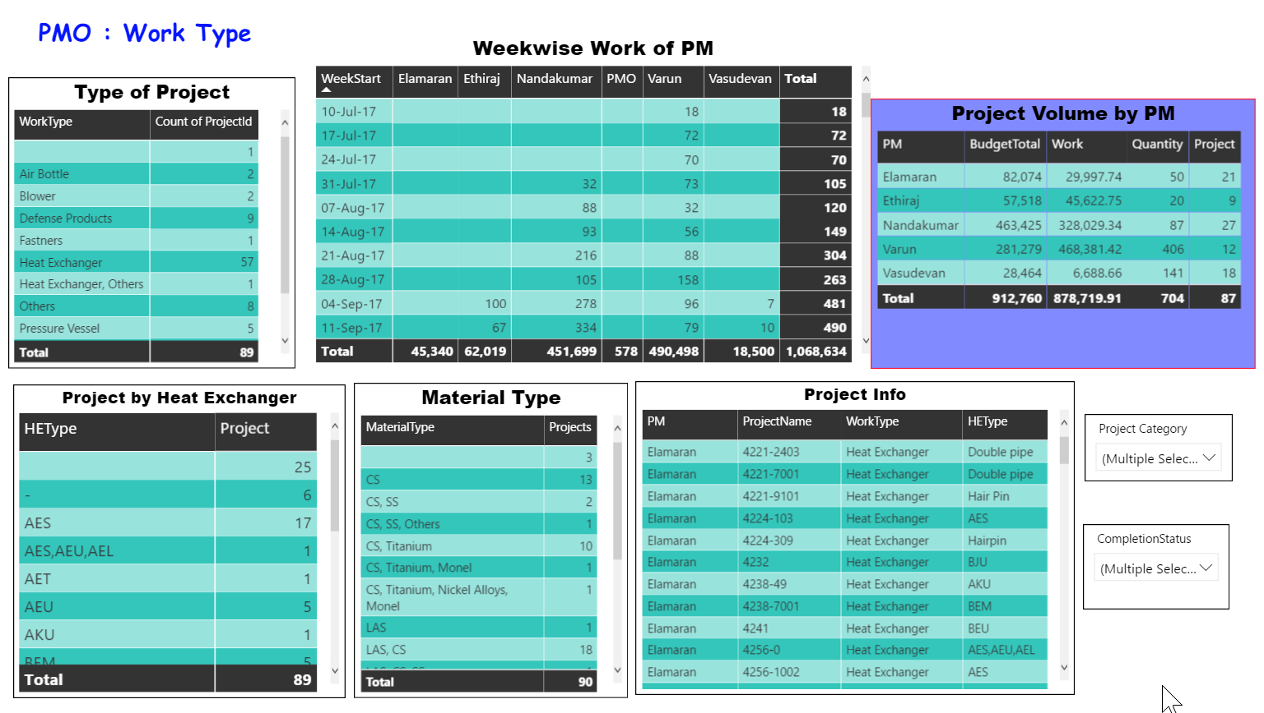
PM Workload Analysis

Slide 34
Project Manager Dashboards

Slide 35
Dashboards for Project Manager
Resourcewise Work on My Project
Risk Tracker
Issue Tracker
Budget Vs Plan Work Analysis
Project S Curve
Project S Curve Data
Milestone Report
Critical Work
Commitment Tracker
Material Tracking Project Wise (All Material)
Material Tracking (Material Wise- All Projects)
Project Plan Updation Report
Department-wise Work Weekly Work
Production Department Weekly Work
Non Production Weekly Work
Planning Defect Report
Checking Plan Correctness
Auto Generated Slide for BRM

Slide 36
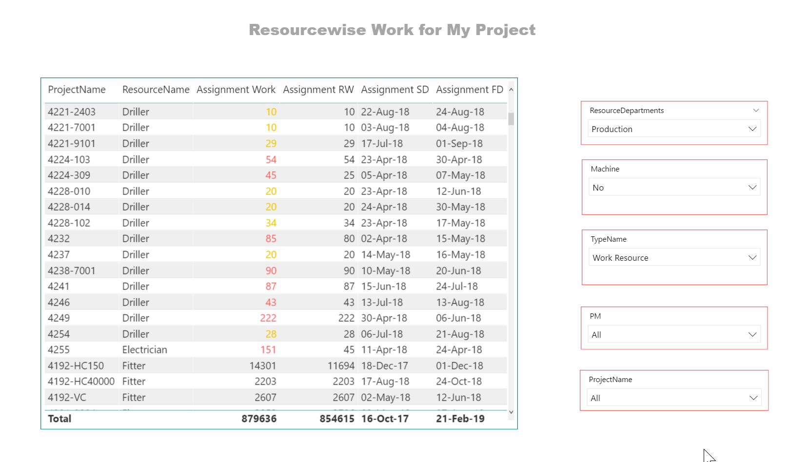
Resourcewise Work on My Project

Slide 37
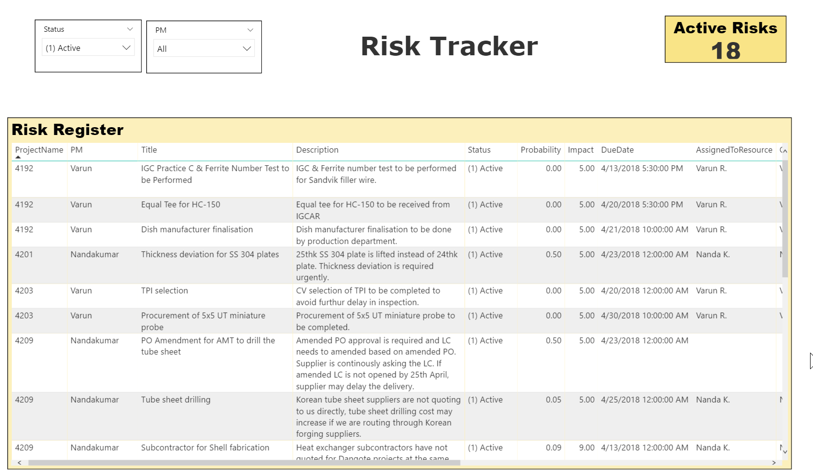
Risk Tracker

Slide 38
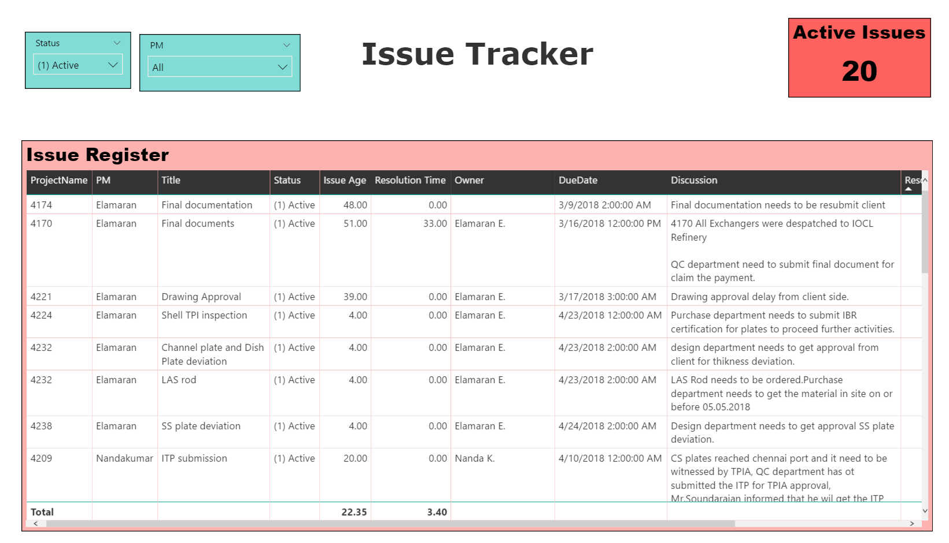
Issue Tracker

Slide 39
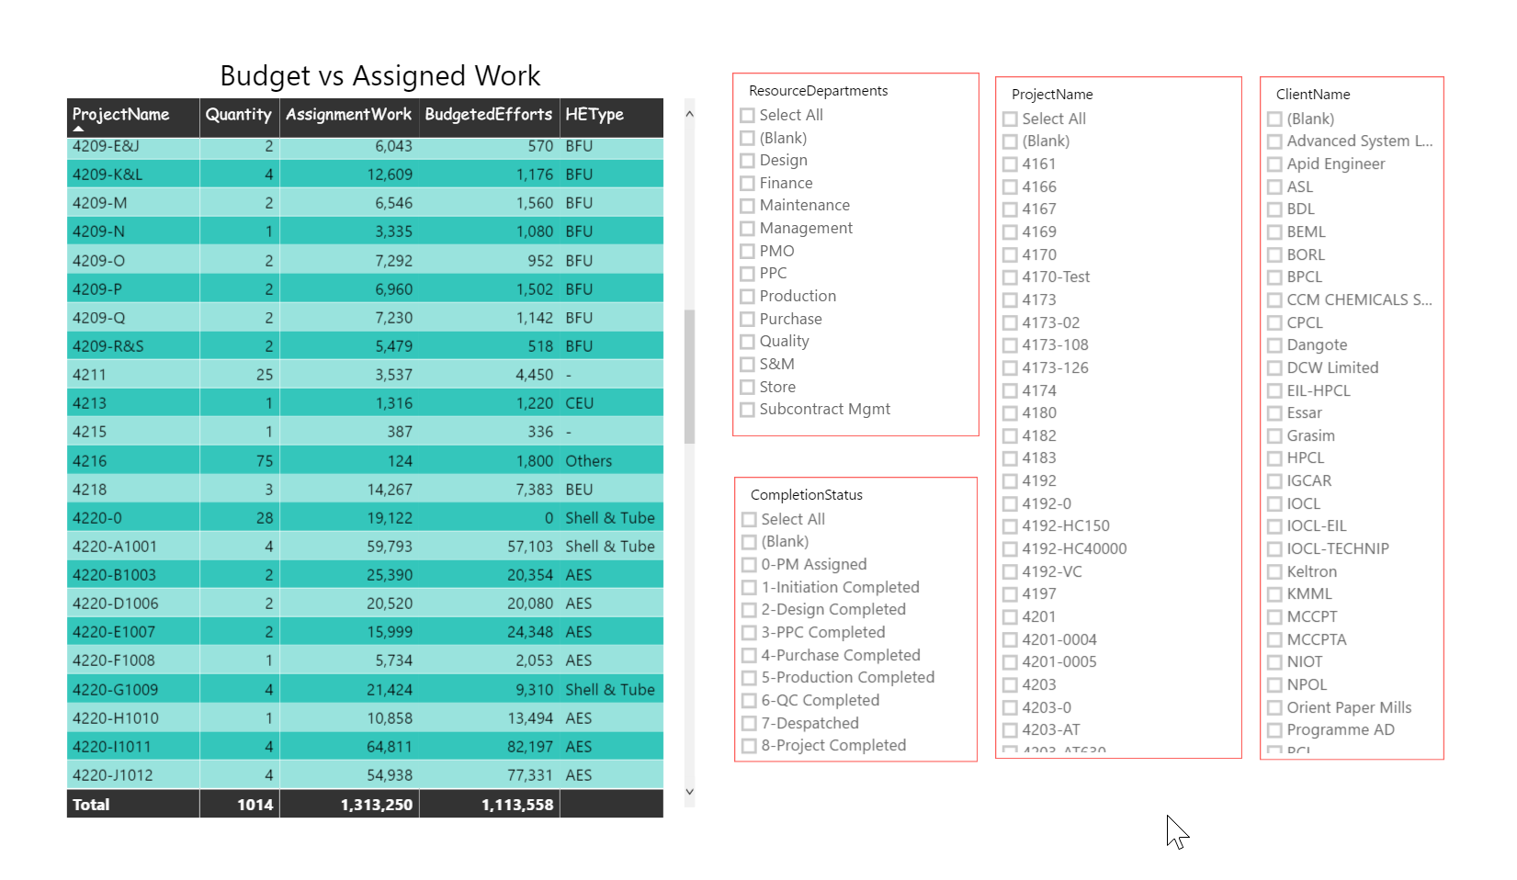
Budget Vs Planned Work

Slide 40
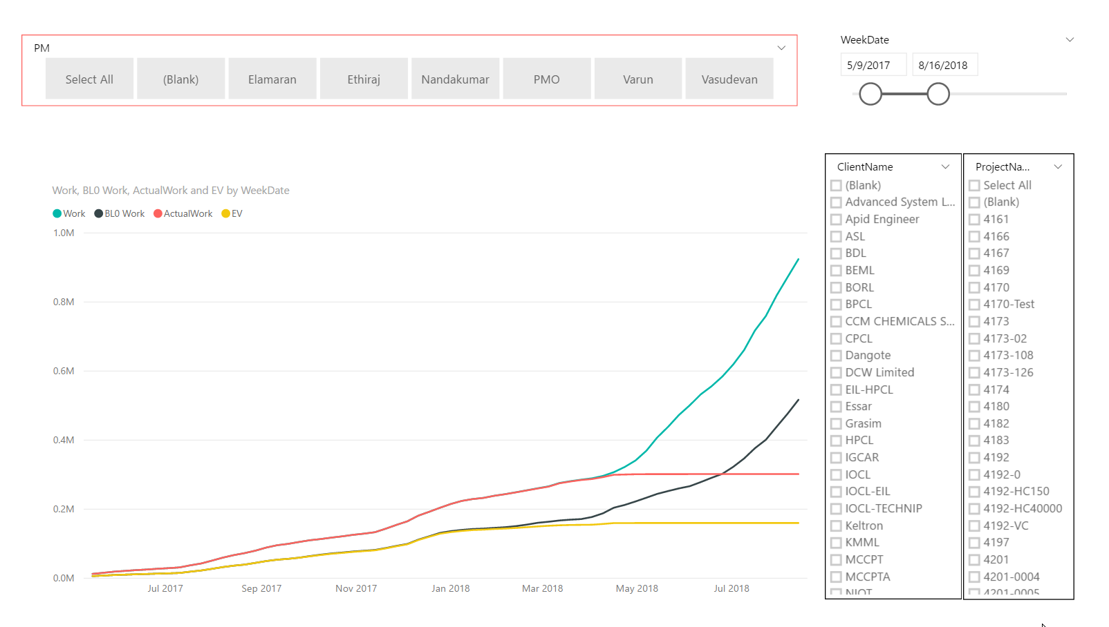
S Curve

Slide 41
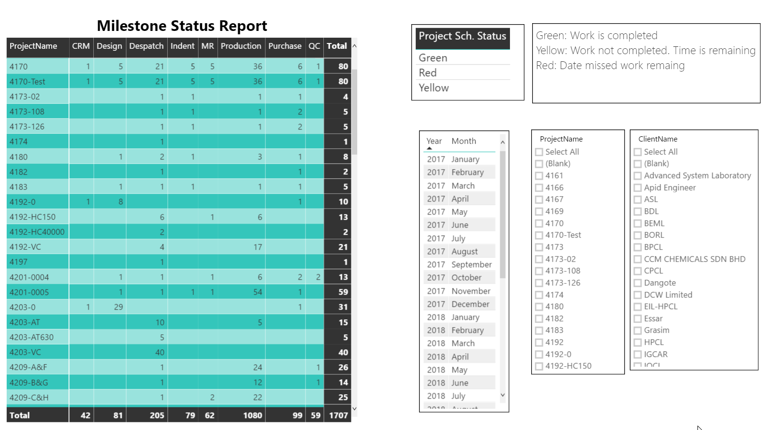
Milestone Report

Slide 42
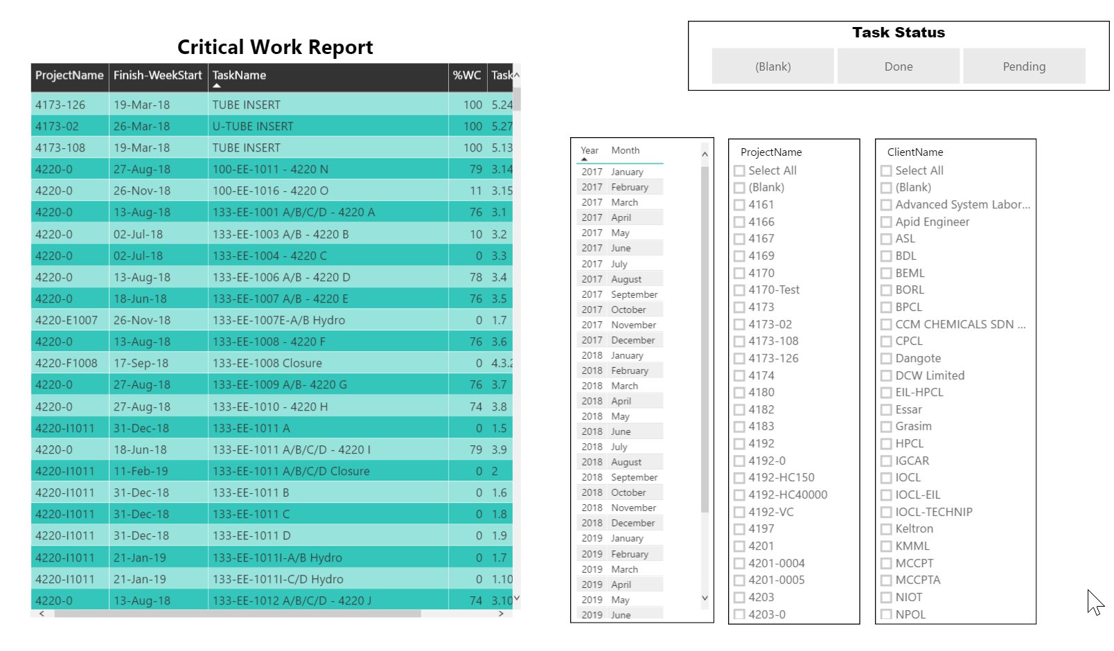
Critical Work

Slide 43
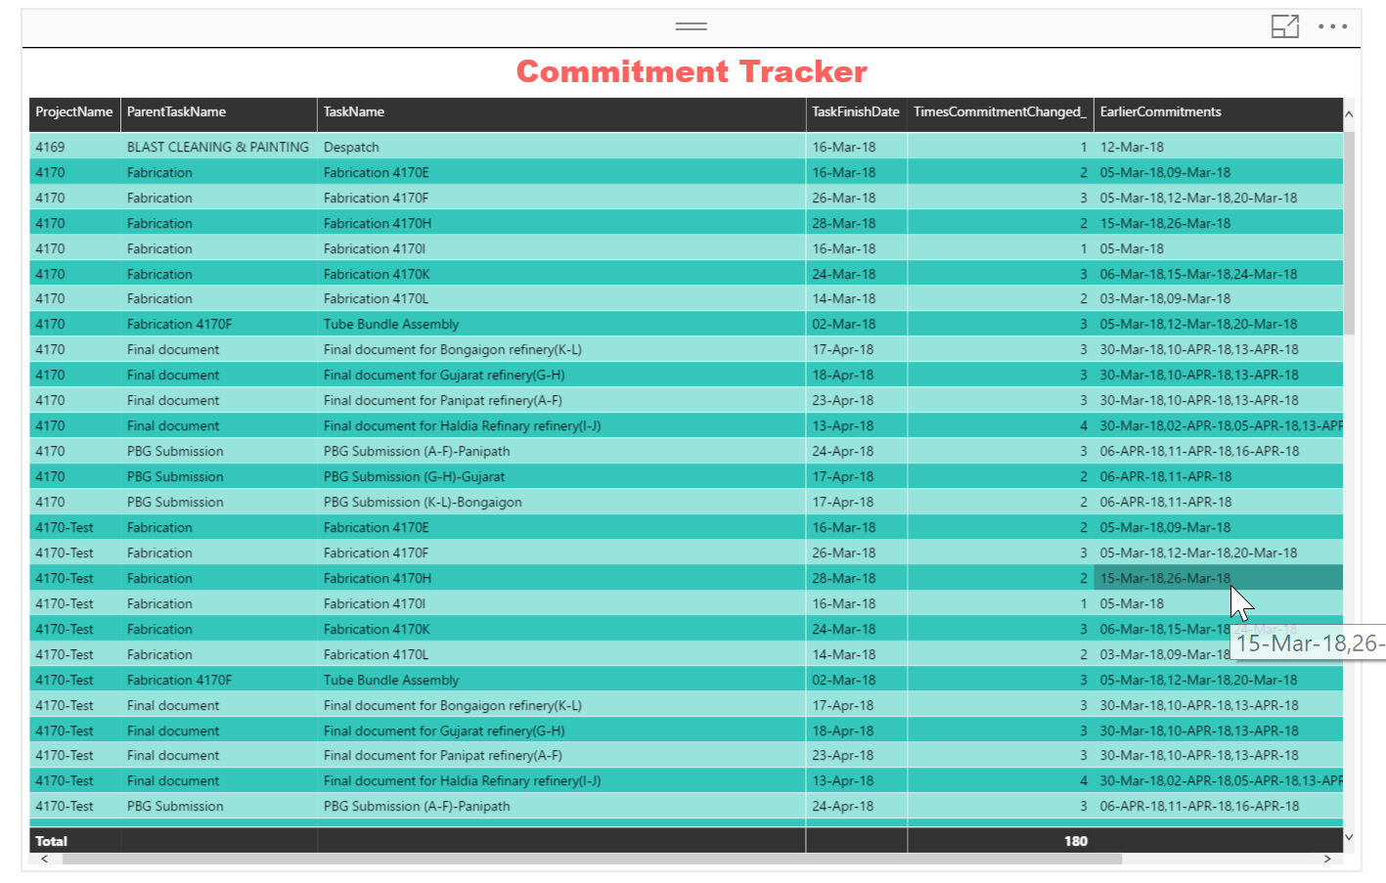
Commitment Tracker

Slide 44
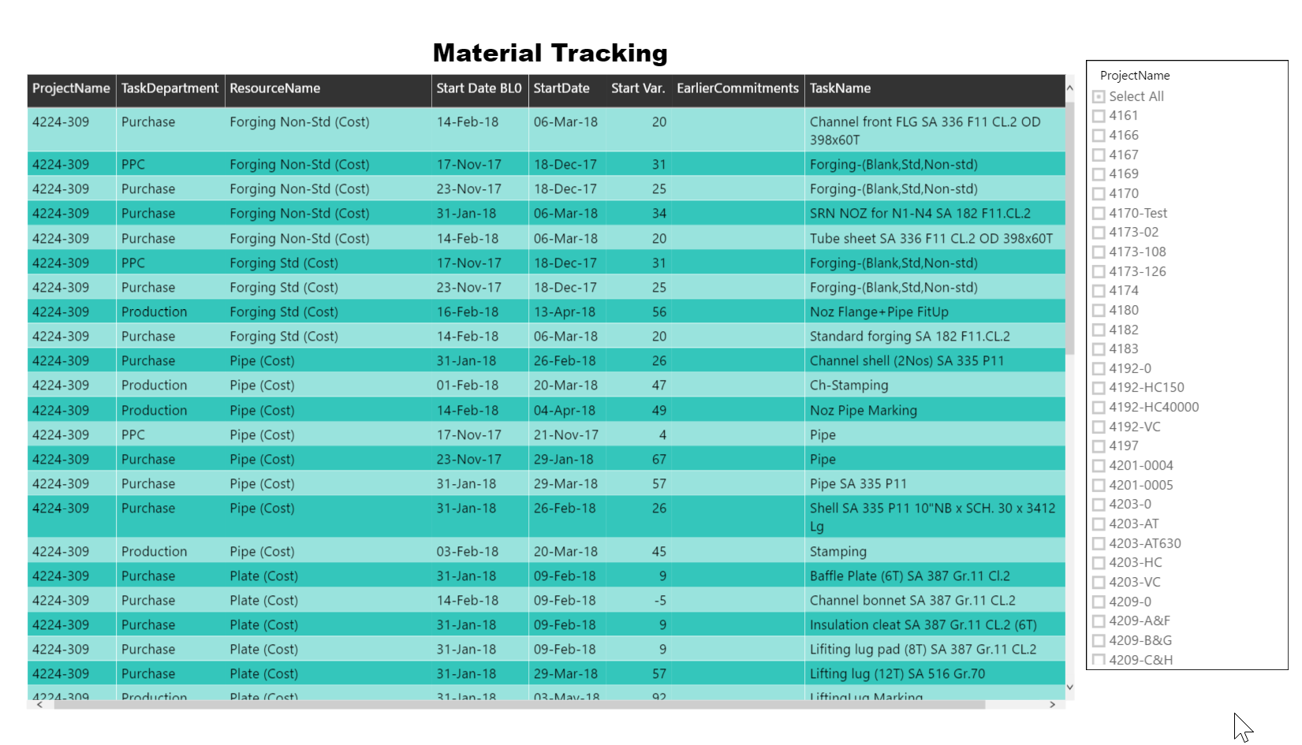
Material Tracking Project Wise (All Material)

Slide 45
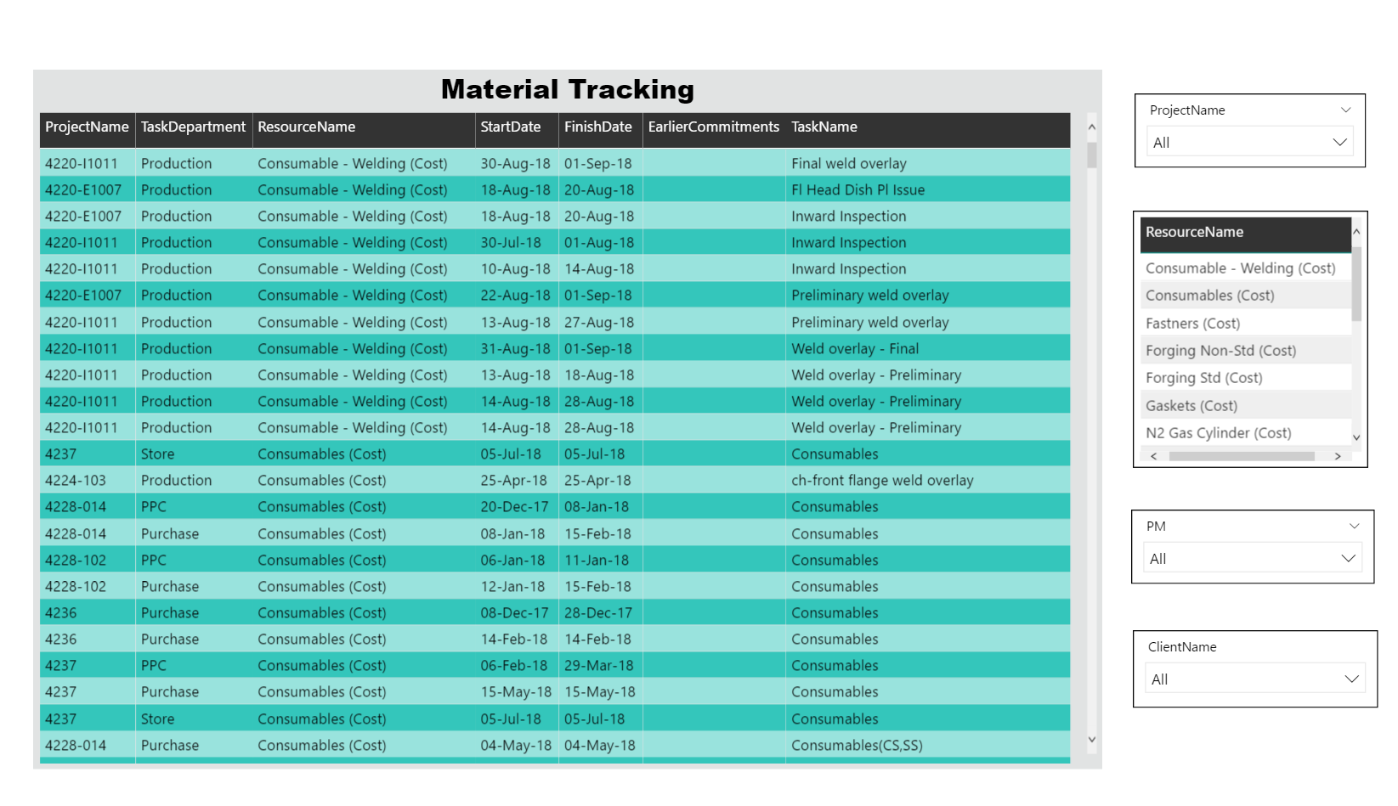
Material Tracking (Material Wise- All Projects)

Slide 46
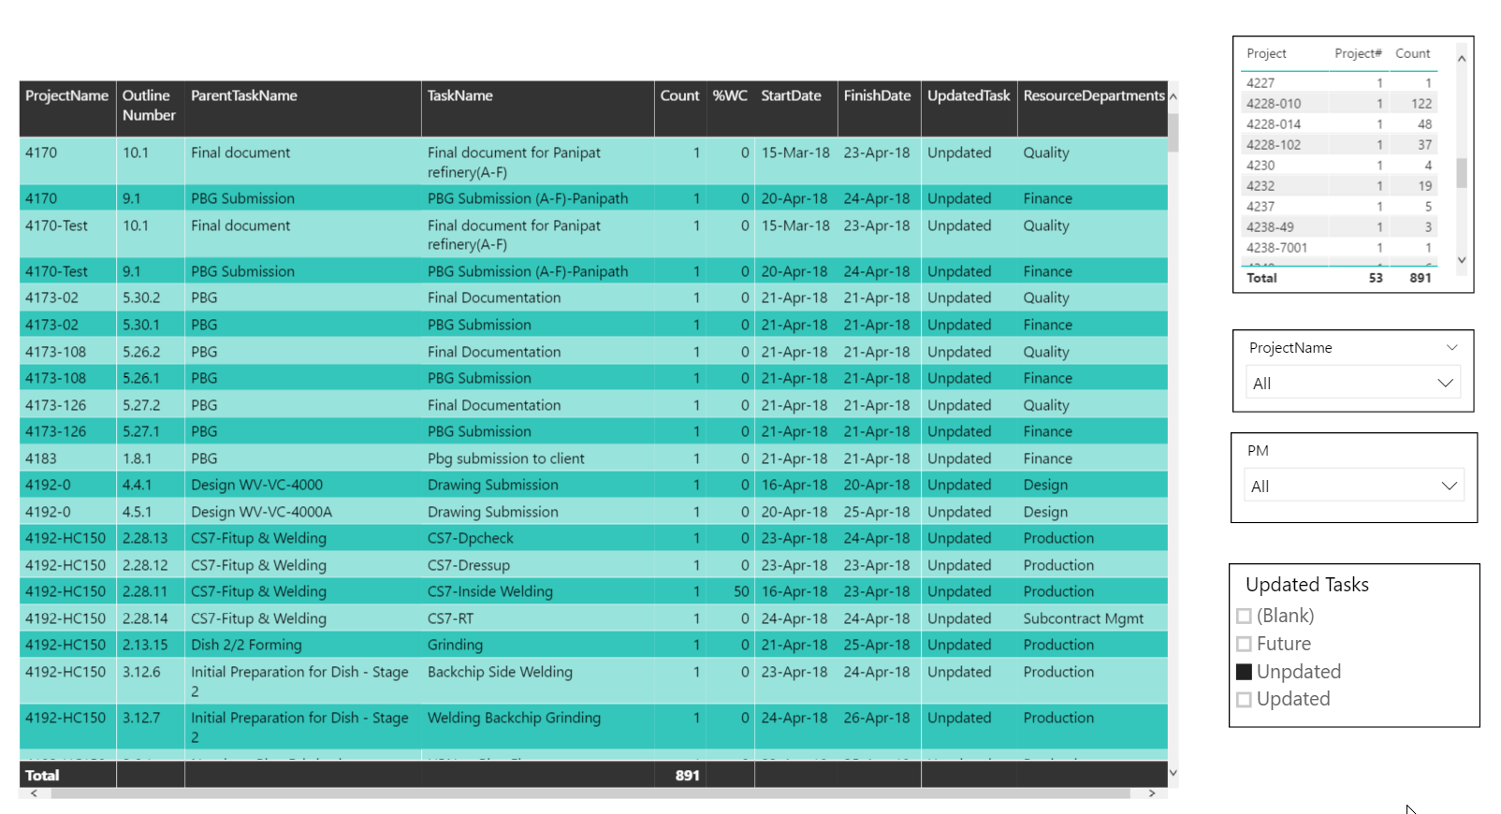
Project Plan Updation Report

Slide 47
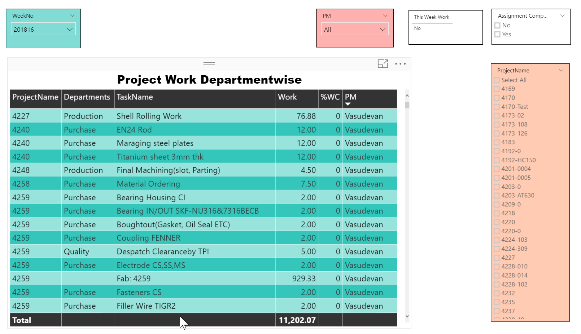
Department-wise Work Weekly Work

Slide 48
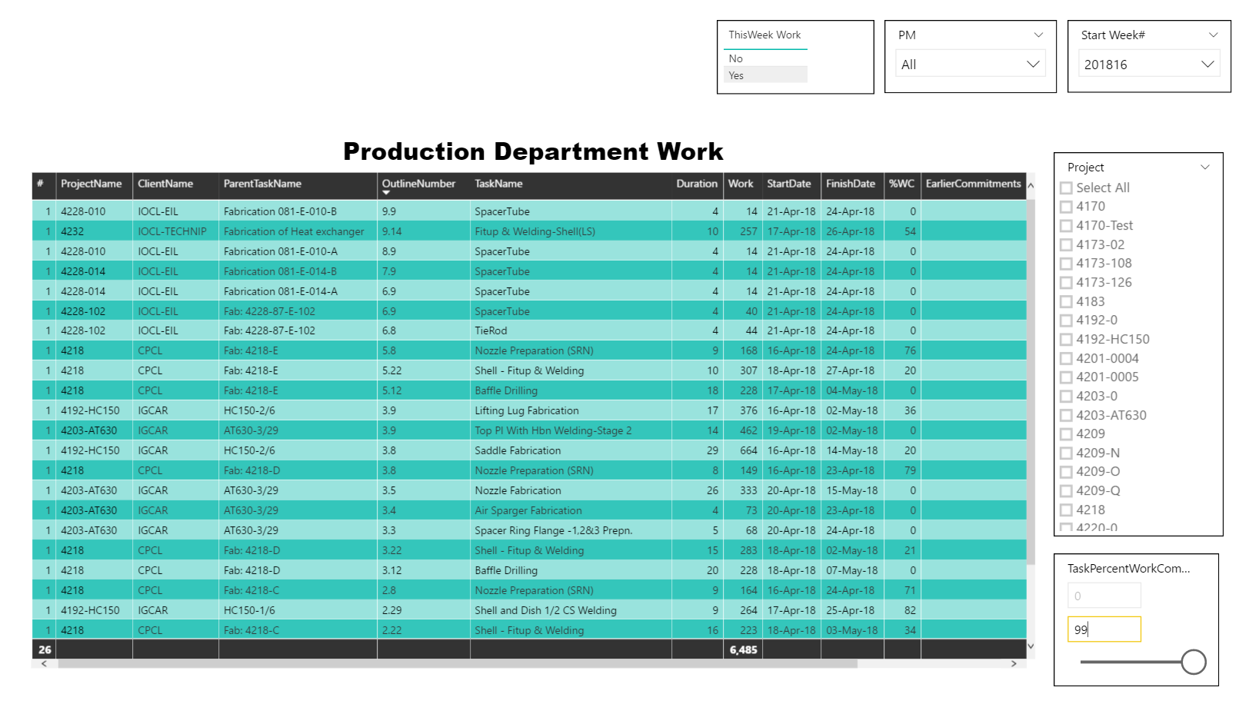
Production Department Weekly Work

Slide 49
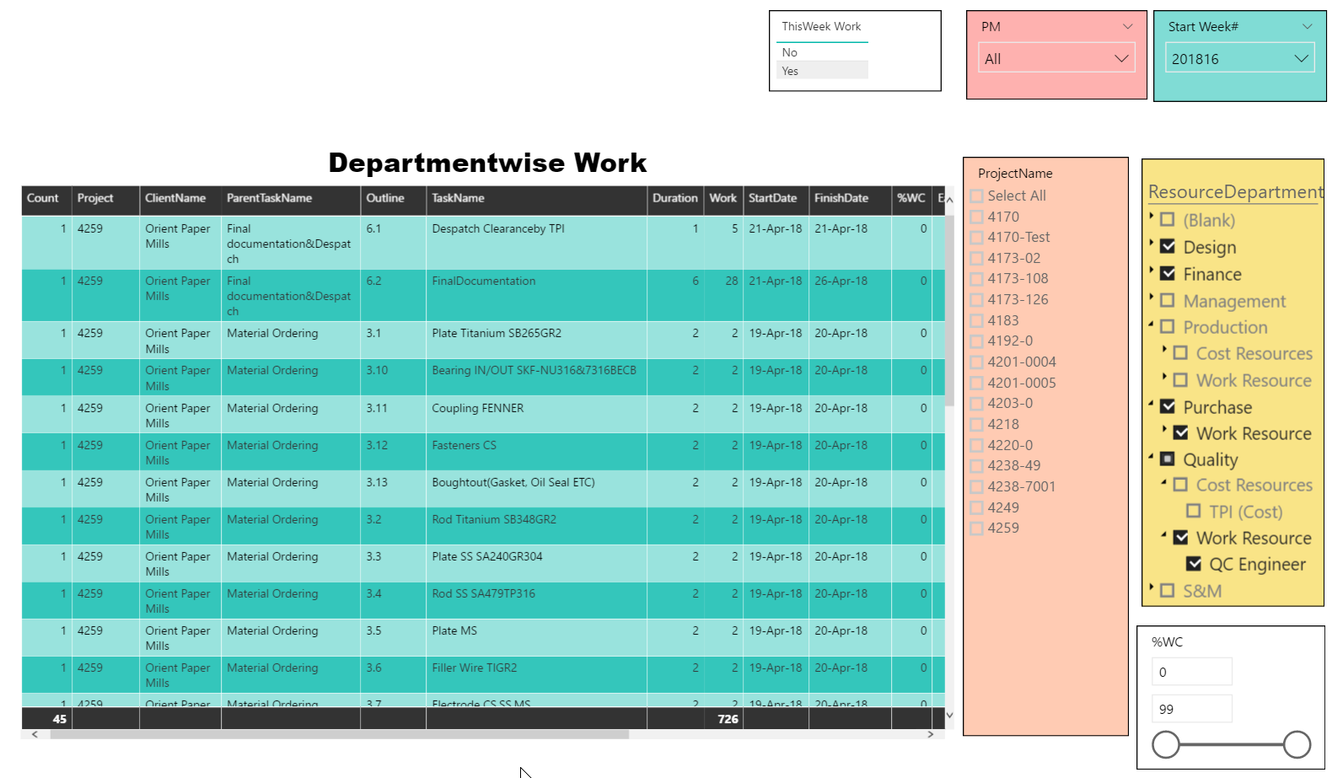
Non Production Weekly Work

Slide 50
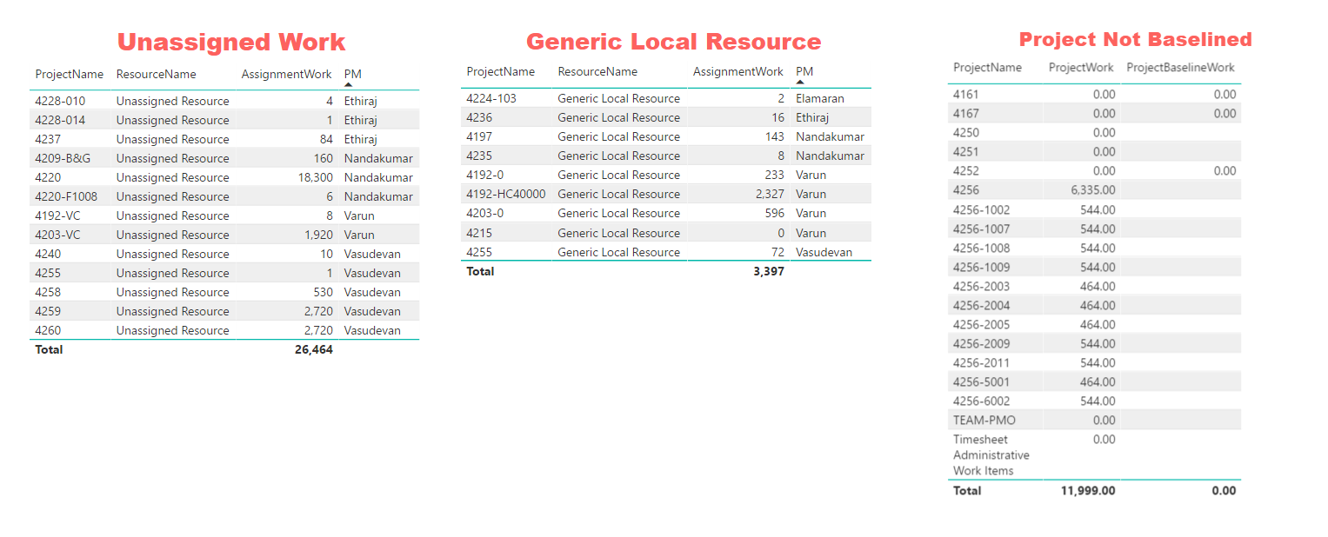
Planning Defect Report

Slide 51
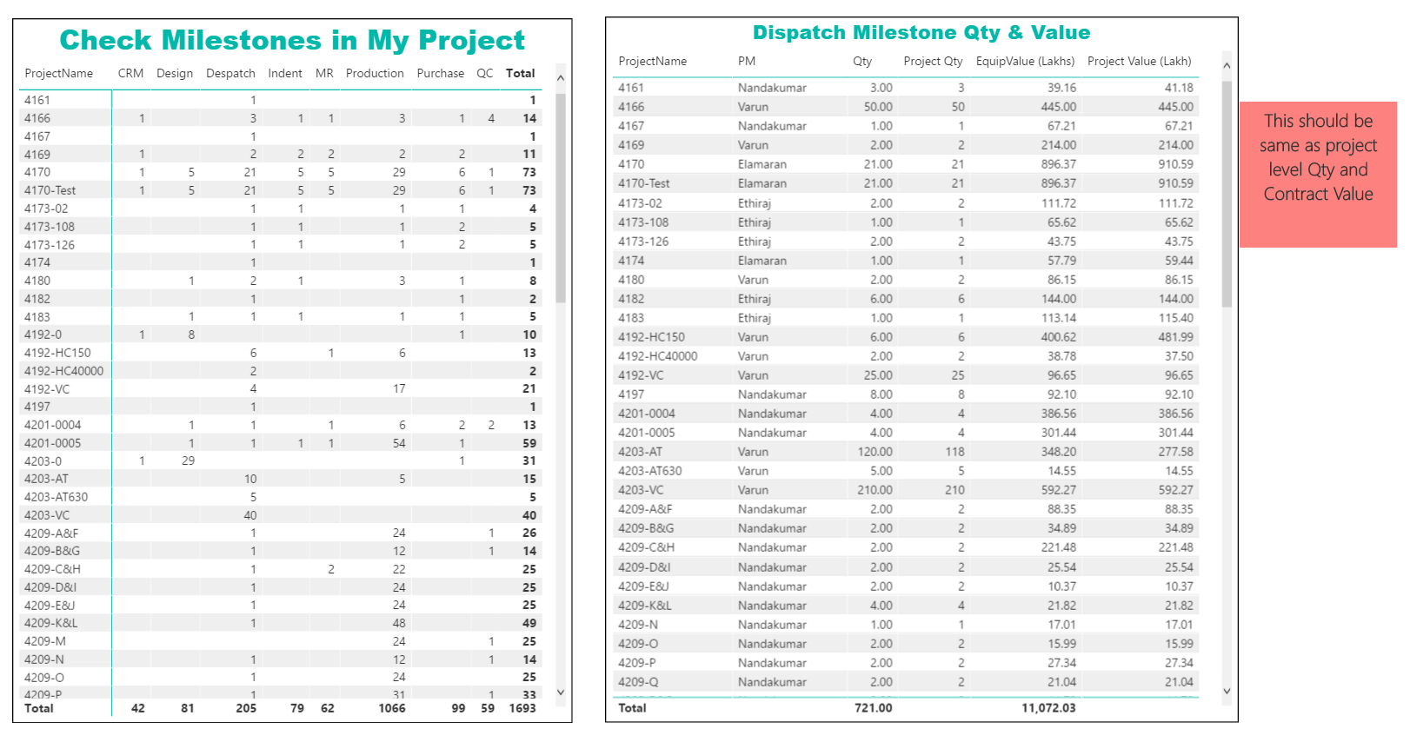
Checking Plan Correctness

Slide 52
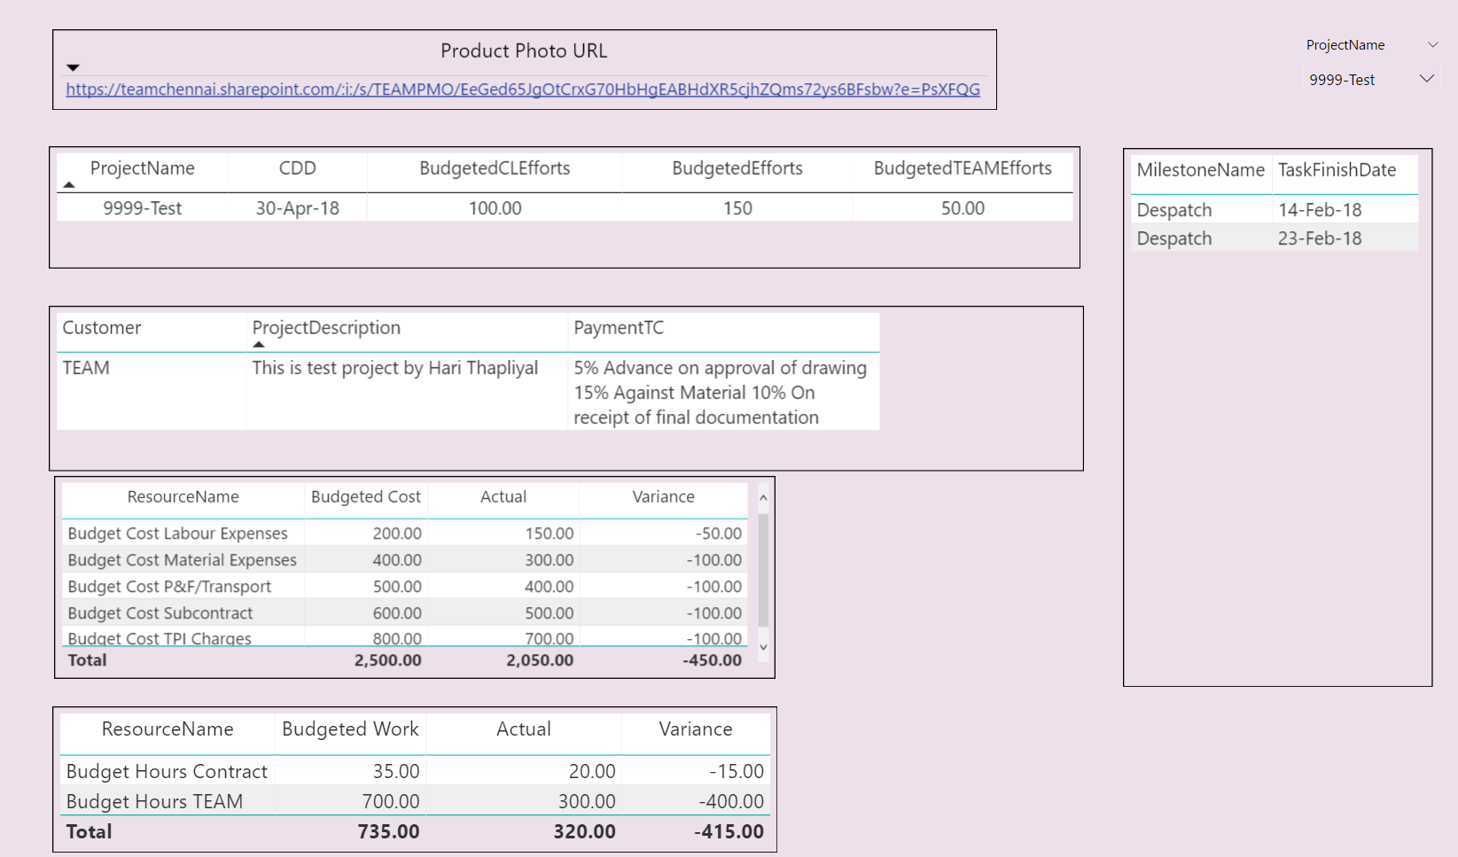
Auto Generated Slide for BRM

Slide 53
PWA Customization

Slide 54
Project Level Customization
# | Field | Department | Entity | Type | Behavior | Formula | Graphical indicators | Lookup Table | Last Updated
1 | Product Photo URL |  | Project | Text | Not required | No | No |  | 12-04-18
2 | Quantity |  | Project | Number | Not required | No | No |  | 01-01-18
3 | Labor Job |  | Project | Text | Not required | No | No | Boolean | 05-01-18
4 | LD (Min %) |  | Project | Number | Required | No | No |  | 07-04-18
5 | LD (Max %) |  | Project | Number | Required | No | No |  | 07-04-18
6 | Budgeted TEAM Efforts |  | Project | Number | Not required | No | No |  | 01-01-18
7 | Delivery Location |  | Project | Text | Not required | No | No |  | 19-04-18
8 | Client Name |  | Project | Text | Not required | No | No |  | 28-12-17
9 | PM |  | Project | Text | Required | No | No | PM List | 21-02-18
10 | WO Date |  | Project | Date | Not required | No | No |  | 12-02-18
11 | Drawing Approval By |  | Project | Text | Not required | No | No |  | 18-04-18
12 | Work Type |  | Project | Text | Not required | No | No | ProductType | 05-01-18
13 | Inspected By |  | Project | Text | Not required | No | No |  | 19-04-18
14 | CDD |  | Project | Date | Required | No | No |  | 09-01-18
15 | Material Type |  | Project | Text | Not required | No | No | Material Type | 05-01-18
16 | Delivery Terms |  | Project | Text | Not required | No | No |  | 19-04-18
17 | Project Departments |  | Project | Text | Not required | No | No | Department | 14-03-18
18 | HE Type |  | Project | Text | Not required | No | No |  | 01-01-18
19 | Completion Status |  | Project | Text | Not required | No | No | Completion Status | 03-01-18
20 | Customer Name |  | Project | Text | Required | No | No | Customers | 19-04-18
21 | LDWeek |  | Project | Number | Not required | No | No |  | 09-04-18
22 | Payment T&C |  | Project | Text | Not required | No | No |  | 12-04-18
23 | LD Min Time UOM |  | Project | Text | Required | No | No | LD Min Time UOM | 07-04-18
24 | Baseline Upto |  | Project | Text | Required | No | No |  | 09-01-18
25 | SM |  | Project | Text | Required | No | No | Sales Managers | 21-02-18

Slide 55
Project Level Customization
26 | Master Plan |  | Project | Flag | Not required | No | No |  | 30-03-18
27 | Budgeted CL Efforts |  | Project | Number | Not required | No | No |  | 01-01-18
28 | Contract Value |  | Project | Number | Not required | No | No |  | 03-01-18
29 | RBS |  | Resource | Text | Not required | No | No | RBS | 29-11-17
30 | Cost Type |  | Resource | Text | Not required | No | No | Cost Type | 29-11-17
31 | Resource Departments |  | Resource | Text | Not required | No | No | Department | 29-11-17
32 | Team Name |  | Resource | Text | Not required | No | No |  | 29-11-17
33 | Machine |  | Resource | Text | Not required | No | No | Boolean | 26-12-17
34 | Qty |  | Task | Number | Not required | No | No |  | 25-01-18
35 | Invoice Date |  | Task | Date | Not required | No | No |  | 12-04-18
36 | ABG Validity Date |  | Task | Date | Not required | No | No |  | 22-03-18
37 | Proposed Date Rejected |  | Task | Flag | Not required | No | No |  | 28-03-18
38 | Proposed Finish Date |  | Task | Date | Not required | No | No |  | 24-03-18
39 | ABG Value |  | Task | Cost | Not required | No | No |  | 12-02-18
40 | Actual Work Against Budget |  | Task | Number | Not required | No | No |  | 12-04-18
41 | % Activity Done |  | Task | Number | Not required | Yes | No |  | 19-04-18
42 | PBG Value |  | Task | Cost | Not required | No | No |  | 12-02-18
43 | Actual Cost Against Budget |  | Task | Cost | Not required | No | No |  | 12-04-18
44 | Flag Status |  | Task | Flag | Not required | No | No |  | 29-11-17
45 | Design Prepared# |  | Task | Number | Not required | No | No |  | 14-02-18
46 | Activity On #Equipment |  | Task | Number | Not required | No | No |  | 12-04-18
47 | Health |  | Task | Text | Not required | No | No | Health | 29-11-17
48 | EarlierCommitments |  | Task | Text | Not required | No | No |  | 23-02-18
49 | Payment Amount |  | Task | Cost | Not required | No | No |  | 12-04-18
50 | Risk |  | Task | Text | Not required | No | No |  | 08-01-18

Slide 56
Project Level Customization
51 | LC End Date |  | Task | Date | Not required | No | No |  | 21-03-18
52 | PBG Validity Date |  | Task | Date | Not required | No | No |  | 22-03-18
53 | Equipment Delivery State |  | Task | Text | Not required | No | No |  | 07-04-18
54 | Design Approved# |  | Task | Number | Not required | No | No |  | 14-02-18
55 | Department Commitment |  | Task | Text | Not required | No | No | Commitment Type | 29-03-18
56 | Invoice # |  | Task | Text | Not required | No | No |  | 12-04-18
57 | Payment Date |  | Task | Date | Not required | No | No |  | 12-04-18
58 | AssignedEV% |  | Task | Number | Not required | No | No |  | 06-03-18
59 | Equipment Value |  | Task | Cost | Not required | No | No |  | 23-03-18
60 | Delay Dueto Proposed Date |  | Task | Duration | Not required | Yes | No |  | 24-03-18
61 | LC Start Date |  | Task | Date | Not required | No | No |  | 21-03-18
62 | MilestoneName |  | Task | Text | Not required | No | No | MilestoneList | 12-02-18
63 | Equipment Delivery Country |  | Task | Text | Not required | No | No |  | 07-04-18
64 | Equipment Delivery City |  | Task | Text | Not required | No | No |  | 07-04-18
65 | Critical Work |  | Task | Flag | Not required | No | No |  | 07-04-18
66 | Task Department |  | Task | Text | Not required | No | No | Department | 26-12-17
67 | RM Location |  | Task | Text | Not required | No | No |  | 02-01-18
68 | Payment Milestone |  | Task | Text | Not required | No | No | Boolean | 02-01-18
69 | Task Location |  | Task | Text | Not required | No | No |  | 02-01-18
70 | Task Vendor |  | Task | Text | Not required | No | No |  | 02-01-18

Slide 57
Lookup Table | Type | Last Updated
Boolean | Text | 26-12-17
Commitment Type | Text | 29-03-18
Completion Status | Text | 20-02-18
Cost Type | Text | 29-11-17
Customers | Text | 23-04-18
Department | Text | 10-01-18
Health | Text | 29-11-17
LD Min Time UOM | Text | 07-04-18
Material Type | Text | 08-01-18
MilestoneList | Text | 13-02-18
PM List | Text | 21-04-18
ProductType | Text | 06-04-18
Project Managers | Text | 21-02-18
RBS | Text | 29-11-17
Sales Managers | Text | 21-02-18

Slide 58
MSP Customization

Slide 59
View, Table and Filter Developed in MSP
A. TEAM-BudgetInfo-View
B. TEAM-Despatch-View
C. TEAM-Finance-View
D. TEAM-GenInfo-View
E. TEAM-ProposedSchedule-Analysis-View
F. TEAM-Purchase-Dept-View
G. TEAM-Resource-View
H. TEAM-Work-Tracking-View
I. TEAM-Work-Tracking-View-2
J. TEAM-Temp

Slide 60
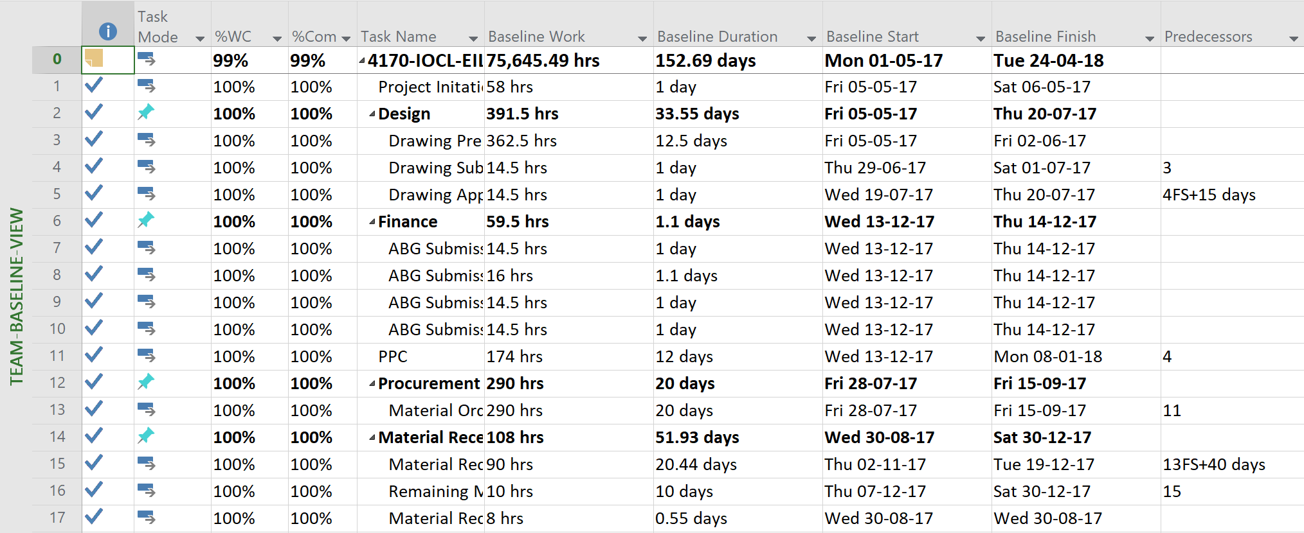

Slide 61
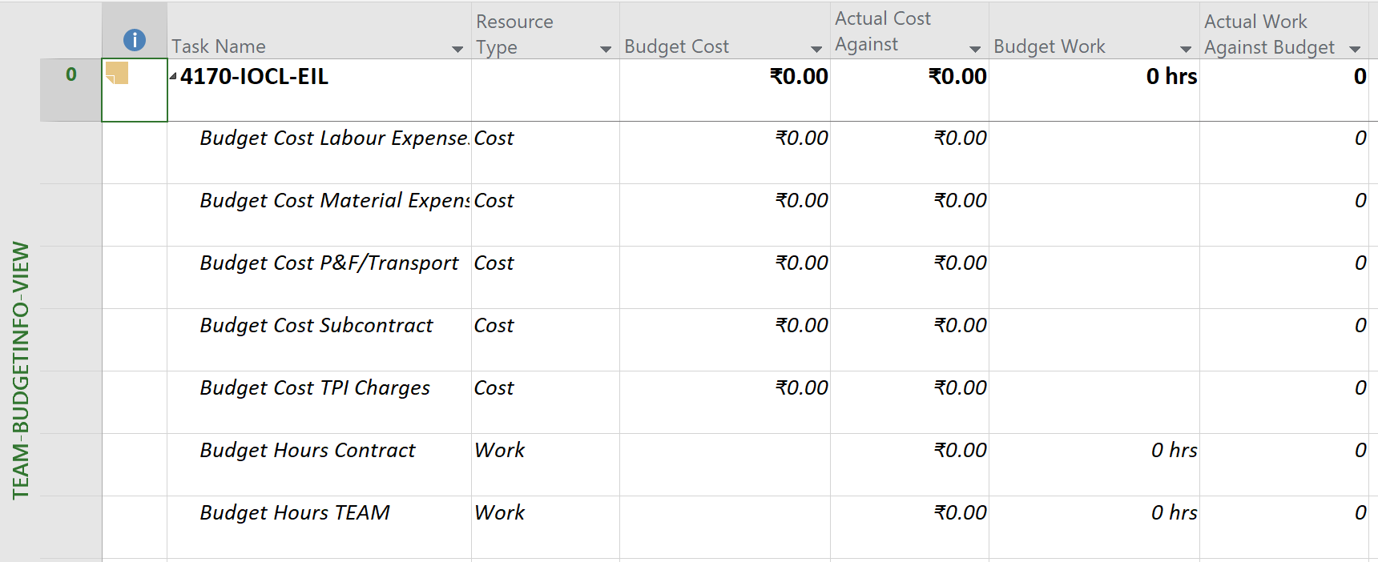

Slide 62
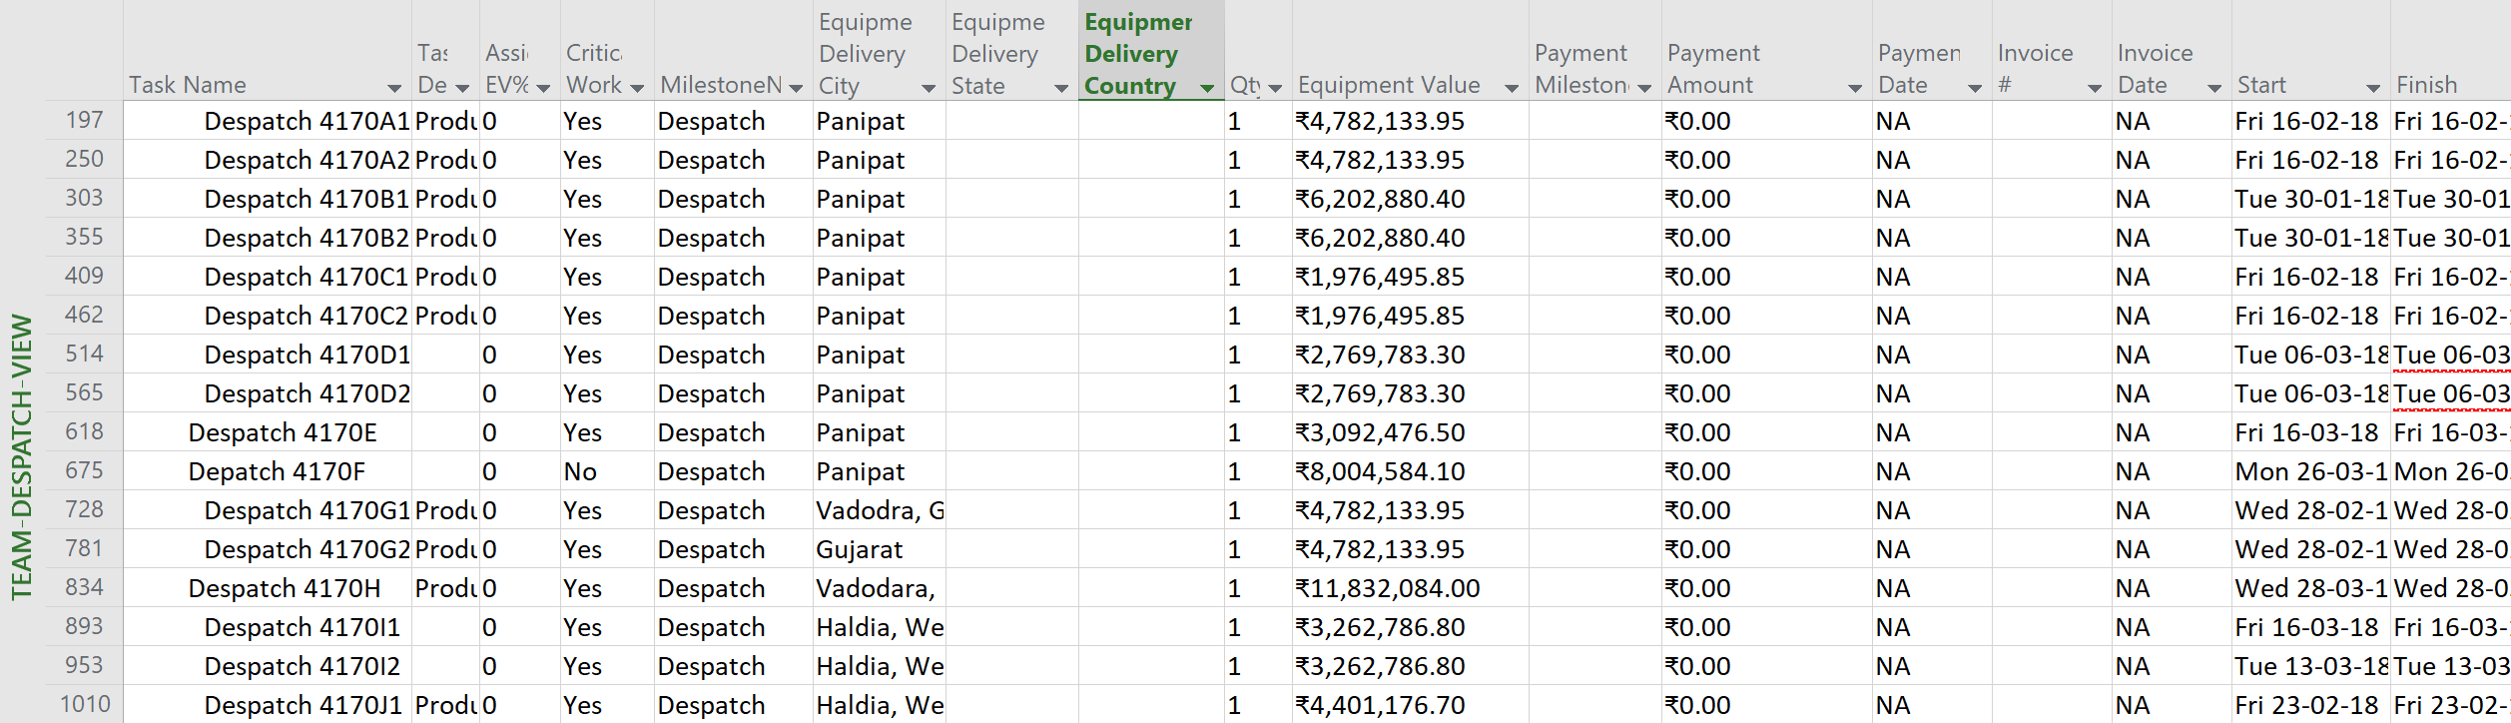

Slide 63
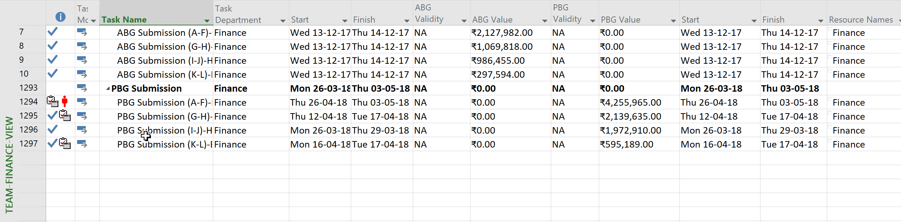

Slide 64
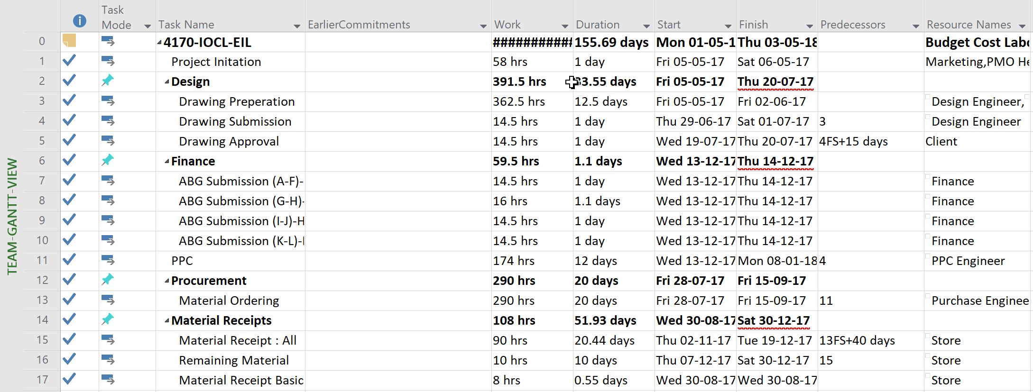

Slide 65
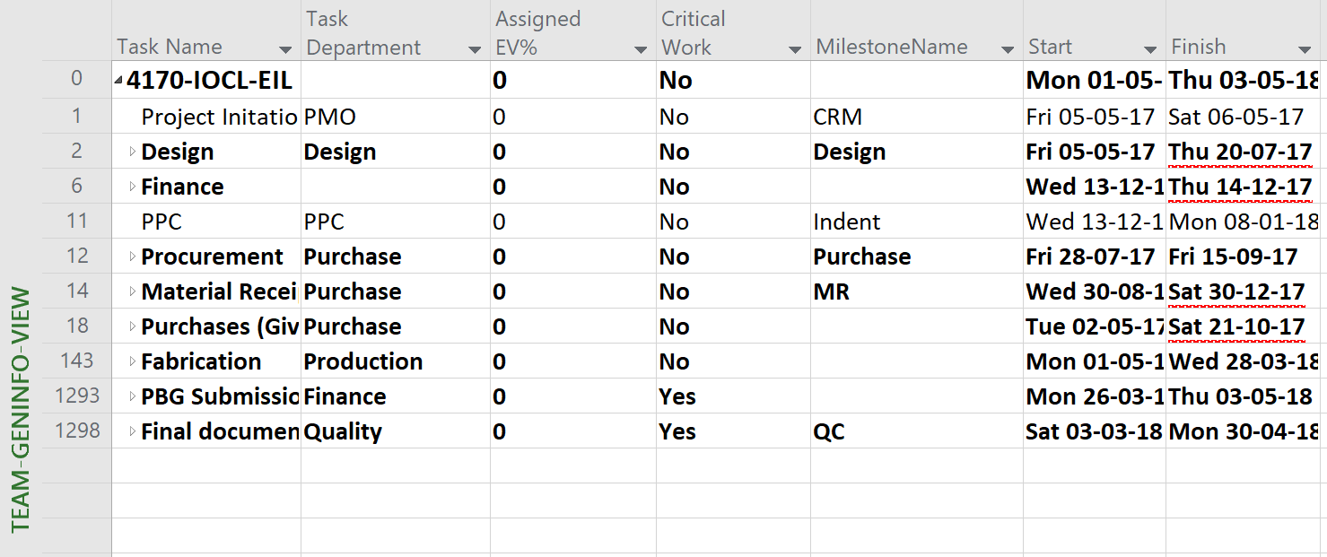

Slide 66
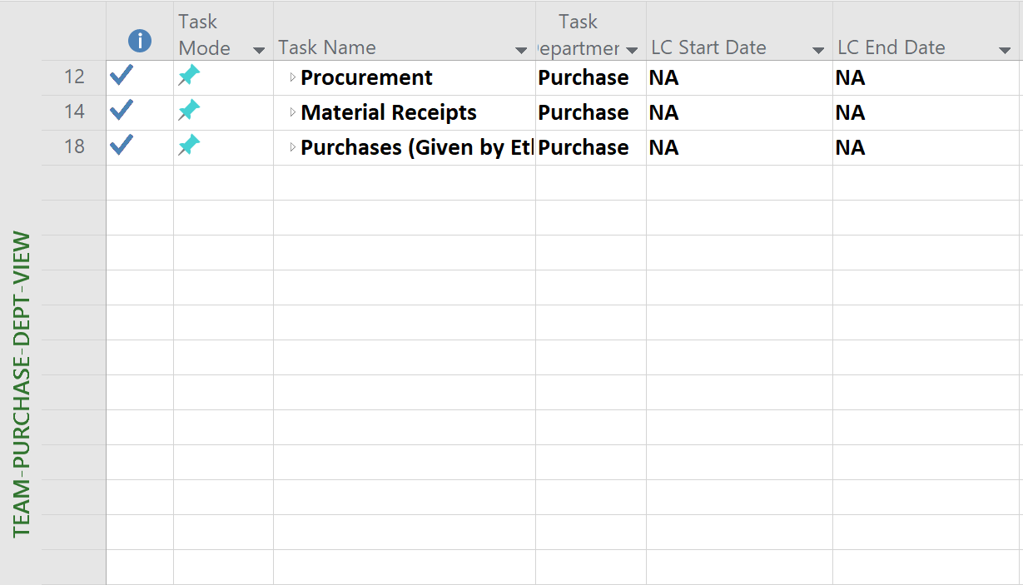

Slide 67
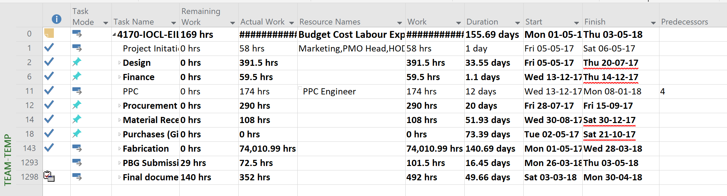

Slide 68
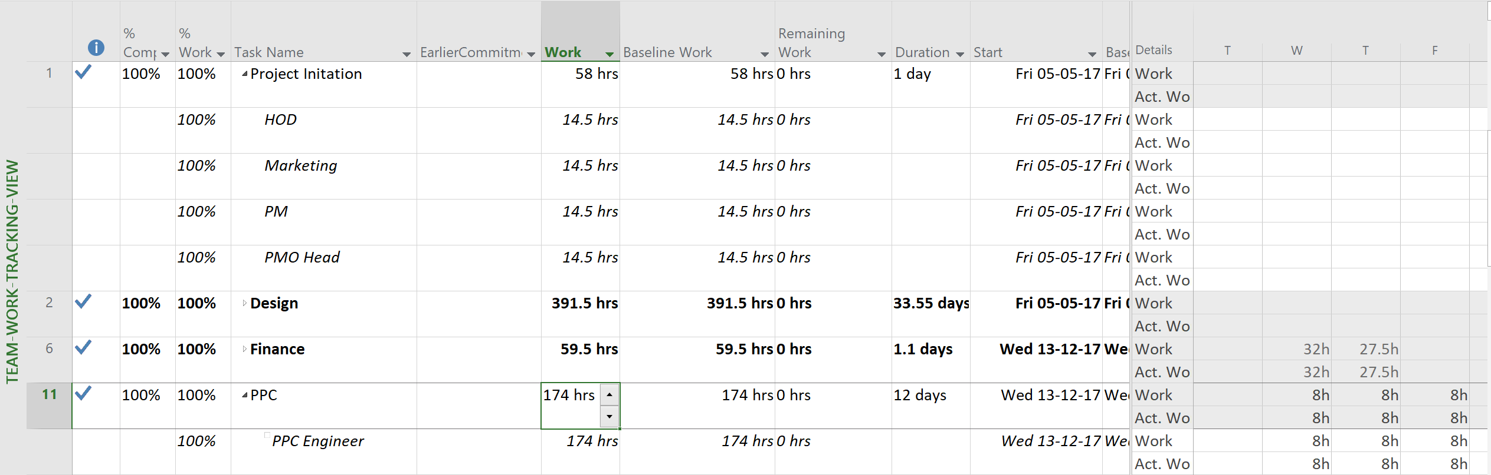

Slide 69
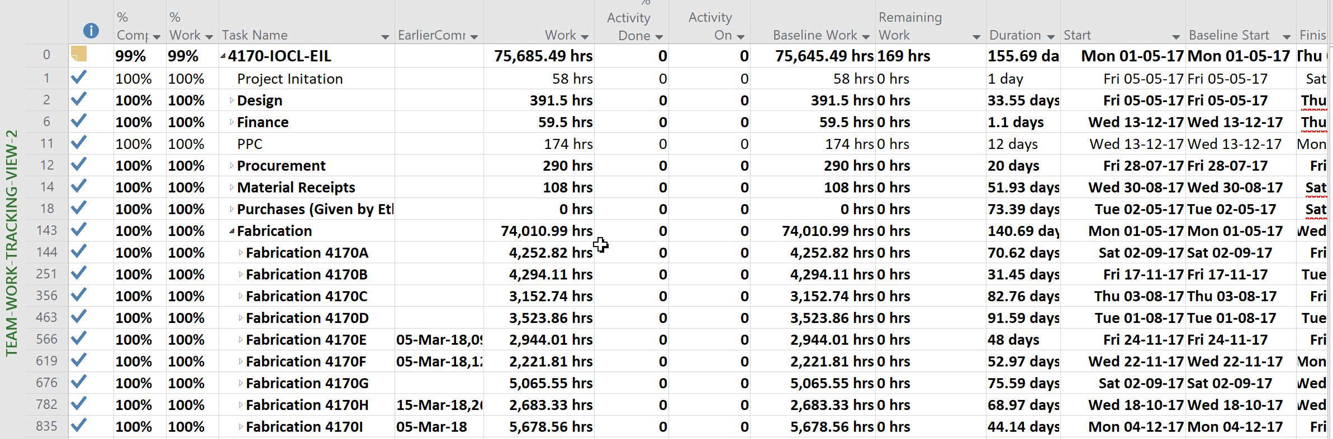

Slide 70
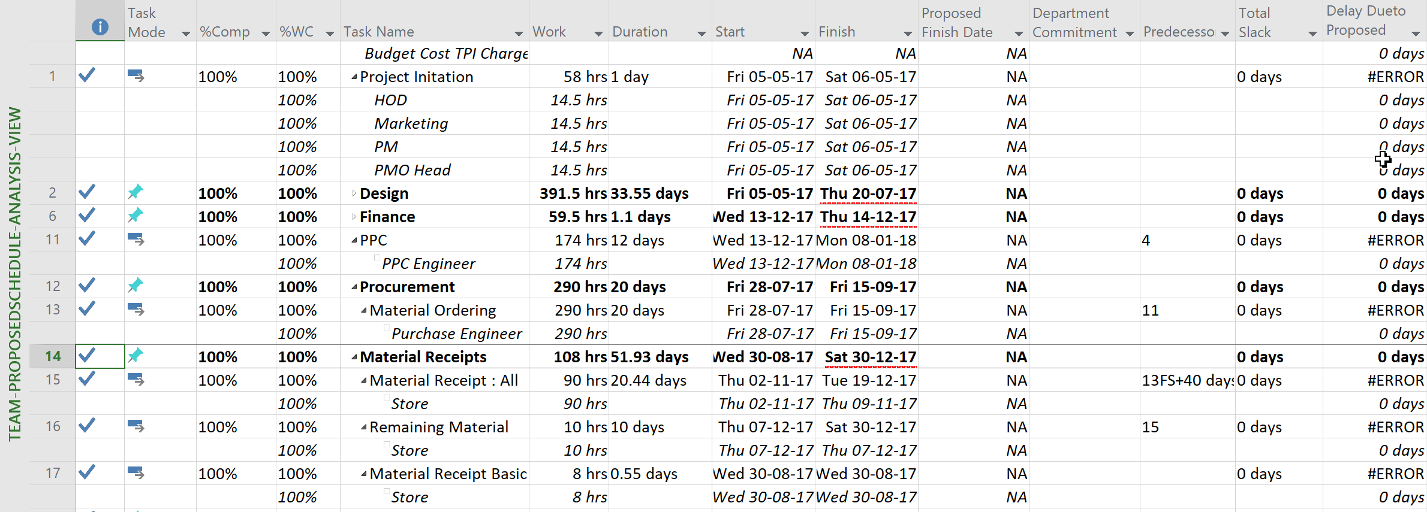

Slide 71
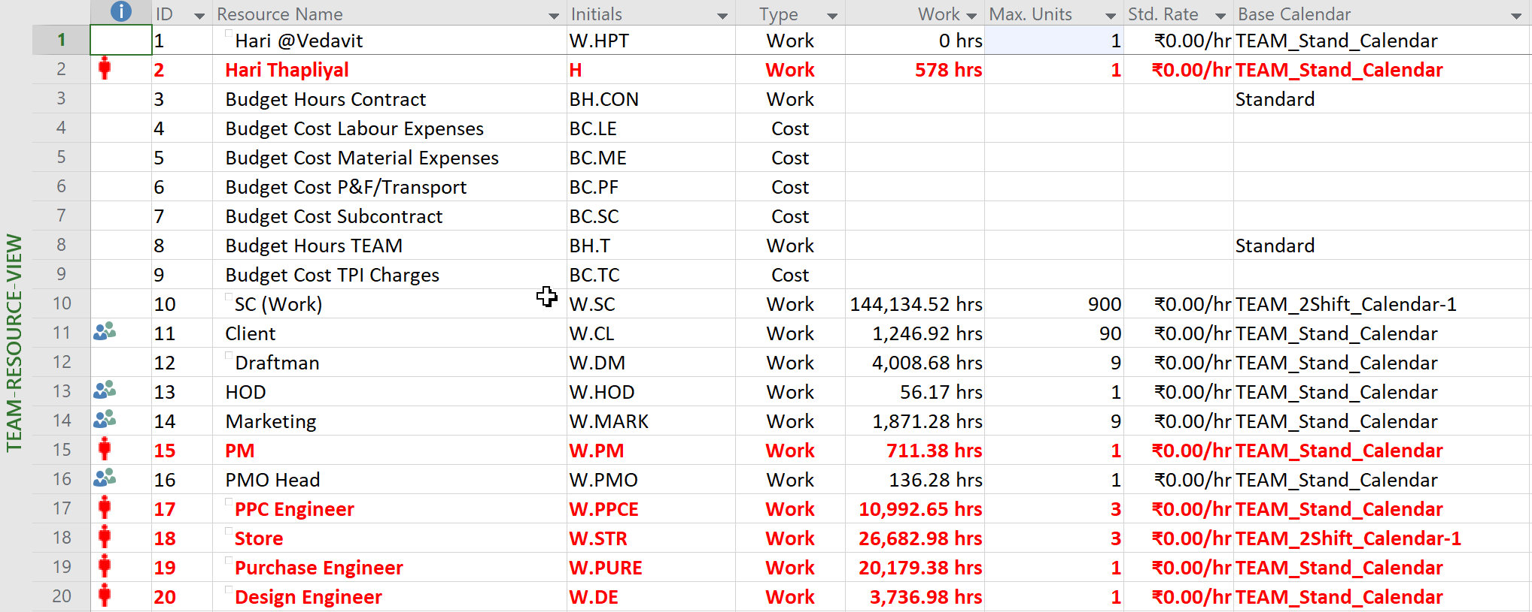

Slide 72
PMO SOPs
01-Kanban Board Updation
02-Daily Standup Meeting
03-Weekly Task-Card Printing
04-Action Register Maintenance
05-Project Schedule Creation
06-Project Schedule Updation
07-Issue Management
08-Risk Management
09-MPR (Monday Project Review) Meetings
10-Project Startup
11-Project Output Dispatch
12-Oracle Data Sync In Power BI
13-Project Creation In PWA
14-MSP Licensing And Payment To Microsoft
15-Tonnage Report Based On BOM
16- PM Assignment To a Project
17-Project Site Creation
18-Negotiating Duration, Time with Departments Before Schedule Baseline
19-Configuration Management, Backup And Restore
20-Project Schedule Review
21-List of Dashboards And Data Refresh
22-Lessons Learn Management – Not being done
23-Project Retrospective Meeting – Not being done.

Slide 73
Follow-on Action Recommendations

Slide 74
Recommendations
Fix internet problem
Smoothen Microsoft payment system (it is subtle but unnecessary big pain taking issue)
Remove block of Microsoft sites from TEAM firewall
Hire one dedicated Project Support (R&R is documented)
Fix configuration management issue (multiple version of same documents floating across the email, desktop, server copies is productivity destructor)
Bring project retrospective culture in the organization
Emphases on metrics driven culture to track the project in project lifecycle
Bring internal project audit culture within organization
Seemless integration of oracle ERP to PWA data (cost, material management/issue, project tracking, delivery & tracking, invoicing) would help TEAM in identifying inefficiencies, ineffectiveness and addressing the issues
One day lessons learned sessions where PM, HODs can present the learning of last month to audience. This should be presentation based formal learning.

Slide 75

Namaste
Thank you

